Slide 1
Align Purpose and design
Janet Salmons, PhD

Slide 2
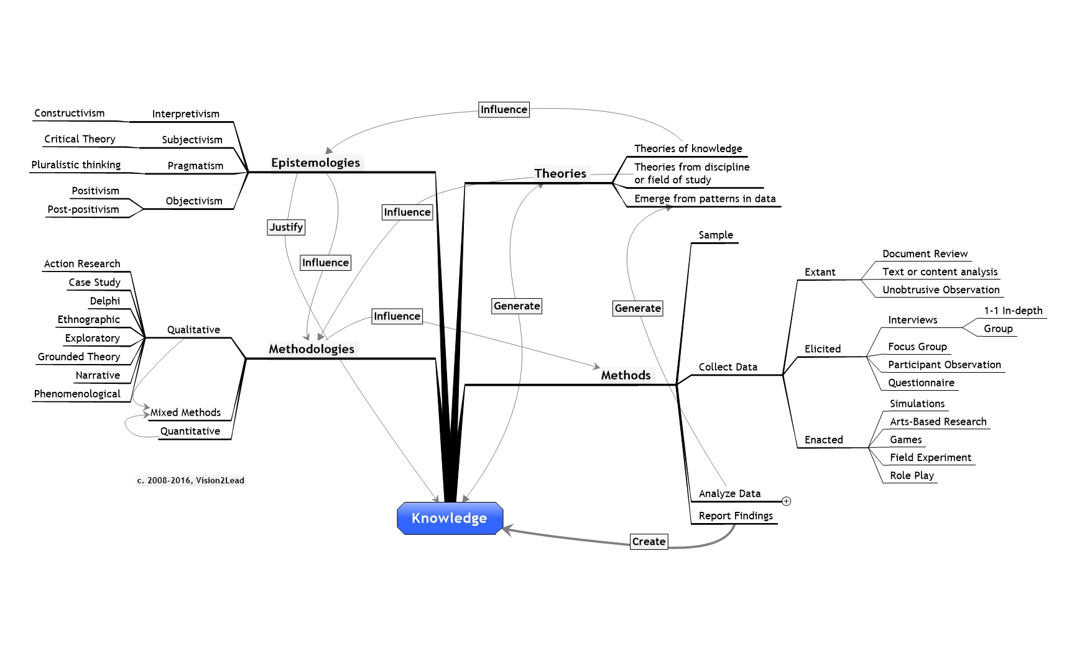
Align Purpose and Design

