Slide 2
Differentiation and personalisation
Neil Denby

Slide 3
Objectives
To consider the range of pupil aptitudes and abilities
To suggest ways by which individual, or personalised, learning can be effected through high levels of differentiation
To discuss differentiation as a means of creating a variety of learning experiences for pupils
To consider personalisation and its possible future

Slide 4
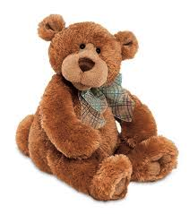
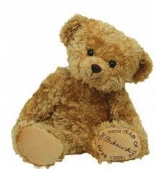
Five bears
In what ways are the bears similar?
In what ways are they different?
What differences are there which are not apparent?

Slide 5
Discussion
In small groups, discuss what your observations tell you about the pupils in your care
Be prepared to share your ideas

Slide 6
Types of difference
Physical: Sight, hearing and mobility
Emotional/Behavioural: ADHD
Learning-orientated Special Educational Needs (SEN)
Learning Difficulties and Disorders (LDD)
Cultural
Social
Special
EAL
…

Slide 7
Discussion
How many of the children in an average-sized class do you think have special needs? Think about all the possibilities – physical, mental, emotional, learning-styles preferences, learning ability, skills possessed …
Who do you think is in the best position to assess these needs – parents and carers, bureaucratic bodies or you, their teacher?

Slide 8
Differentiation
Having a range of activities or routes through a lesson is called ‘differentiation’
Taking differentiation to its logical conclusion would mean creating a different learning plan or route for each pupil, and is called ‘personalisation’

Slide 9
Mapping
For any learner, you should have a five-phase ‘map’ so that you can set appropriate, personalised, targets. These phases are:
･ Where are they now?
･ How do you know this?
･ Where do you want them to be?
･ How will they get there?
･ How will you know that they have arrived?

Slide 10
Differentiation by ‘outcome’
Differentiation is by ‘outcome’, i.e. how well each pupil performs
Easier to prepare and manage
For many of the pupils, the level will not be right (whether too high or too low is equally problematic)

Slide 11
Pupil-centred approach
For each lesson or series of lessons, you will need to decide what the underlying essential learning is going to be for each pupil (group), and how they can best achieve this
In addition, you will need further targets – and possibly more complex tasks – for the more able, and to plan appropriate support and interventions for weaker pupils

Slide 12
Differentiation by …
People
Methods
Materials

Slide 13
Responses by …
Writing
Picture
Cartoon
Poem
Rap
Piece of music
Text message
Speech
Diagram
Spider diagram
Webpage
Song lyrics
Mnemonic …

Slide 14
Personalisation: 5 key strands
Five key strands are:
The use of assessment for learning (Black & William, 1998, 2001) to establish where pupils are and how to move them on
Teaching for learning – planning teaching to be motivating and transferable
Creating choice within the curriculum
Engaging parents and communities so that learners perceive themselves as members of a wider social body
Listening to the student voice

