Slide 1
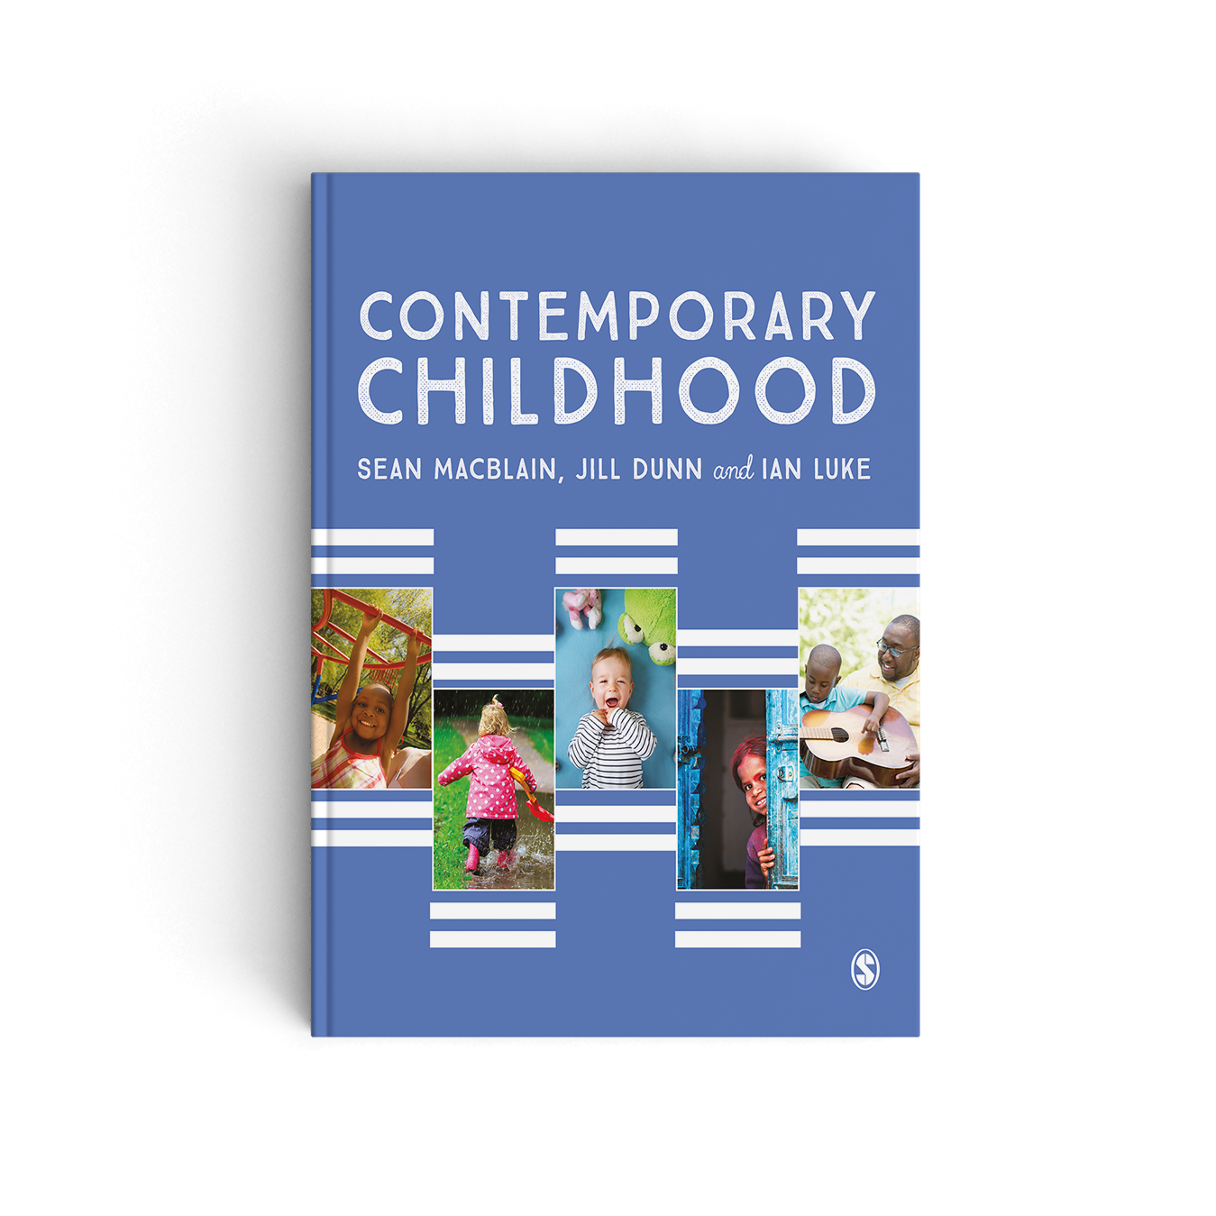
Chapter 4 Creating Optimum Learning Environments for the Child

Slide 2
Identification and Assessment
Key to creating optimum learning environments is the accurate identification and assessment of children’s learning.
Each day teachers and early years practitioners engage in assessment of their pupils’ learning. All too often, however, identification of individual learning needs takes place on a random basis.
Inaccurate identification can mean that for too many children their specific learning needs fail to be recognised, leading to future failure.

Slide 3
The challenges
Teachers and early years practitioners currently face a range of challenges working with young children especially those who have few positive learning experiences in their homes prior to entering early years settings.
The nature and quality of children’s early language experiences learned at home will impact on their future learning.
Frequently, early years practitioners and teachers need to create environments that compensate for poor learning experiences at home.

Slide 4
Focus on theory
Identification and assessment of children’s individual learning needs must go far beyond simply looking for what might be ‘wrong’ with the child; it should also focus upon the learning environments that are being and have, in the past, been created by adults.
In an attempt to understand what constitutes effective teaching and learning in schools and thereby accurate identification and assessment, Hattie (2008) synthesised findings from research spanning ten years, which involved thousands of children.

Slide 5
Making teaching and learning visible
Hattie determined six areas that play a major part in learning: the children themselves, their homes; their teachers, their schools, the curricula they received, and the teaching and learning approaches that took place in their schools.
Hattie (2012; Hattie and Yates, 2014) then proposed that the key to making real differences in children’s learning is the need to make teaching and learning ‘visible’ i.e. where teachers actively engage in critical and reflective evaluation of their own teaching and then seek to view and understand learning through the eyes of the children they teach.
He also saw the expectations and perceptions of pupils’ abilities and potential that their teachers held as being a crucial element in creating optimum learning environmets.

Slide 6
A new taxonomy – the work of Marzano
Marzano emphasised how ‘good’ teachers:
Set clear goals and offer clear feedback;
Actively support pupils in their interactions with knowledge and new learning;
Set clear rules, which they insist are observed and followed;
Establish and maintain positive relationships with their pupils; and
Purposely communicate high expectations of them.
(Marzano, 2005; Marzano, and Kendall, 2006; Marzano, 2007)

Slide 7
A new taxonomy – the work of Marzano
Marzano’s notion of a new taxonomy is comprised of three systems: the Self-System, the Metacognitive System, and the Cognitive System; these are in addition to a separate Knowledge Domain and are key to purposeful and effective thinking and learning.
As children are tasked with commencing an activity that is new to them, their Self-System engages in a process whereby they must decide whether to engage actively with the new activity or instead just continue with the activity they are already engaged in. Once engaged the child’s Metacognitive System then sets goals and monitors progress. The child’s Cognitive System then engages in processing the new information with existing information whilst the child’s Knowledge Domain provides the content, based on what the child already knows.

Slide 8
Activity
View the following YouTube video entitled, The Art & Science of Teaching, in which Marzano’s ideas on teaching and children’s learning are discussed together with effective means by which teachers can maximize impact upon children’s learning:
https://www.youtube.com/watch?v=YhB_R_FT9y4
Then discuss with others examples of times when you have worked with children and used particular verbal strategies to extend their learning.

Slide 9
References
Hattie, J. (2012) Visible Learning for Teachers: Maximising Impact on Learning. London: Routledge.
Hattie, J. and Yates, G.C.R. (2014) Visible Learning and the Science of How We Learn. London: Sage.
Marzano, R. (2005) School Leadership that Works: From Research to Results. Alexandria, VA: ASCD.
Marzano, R. (2007) The Art and Science of Teaching: A Comprehensive Framework for Effective Instruction. Alexandria, VA: ASCD.
Marzano, R. and Kendall, J.S. (2006) The New Taxonomy of Educational Objectives (2nd edn). Thousand Oaks, CA/London: Sage.

