Slide 1
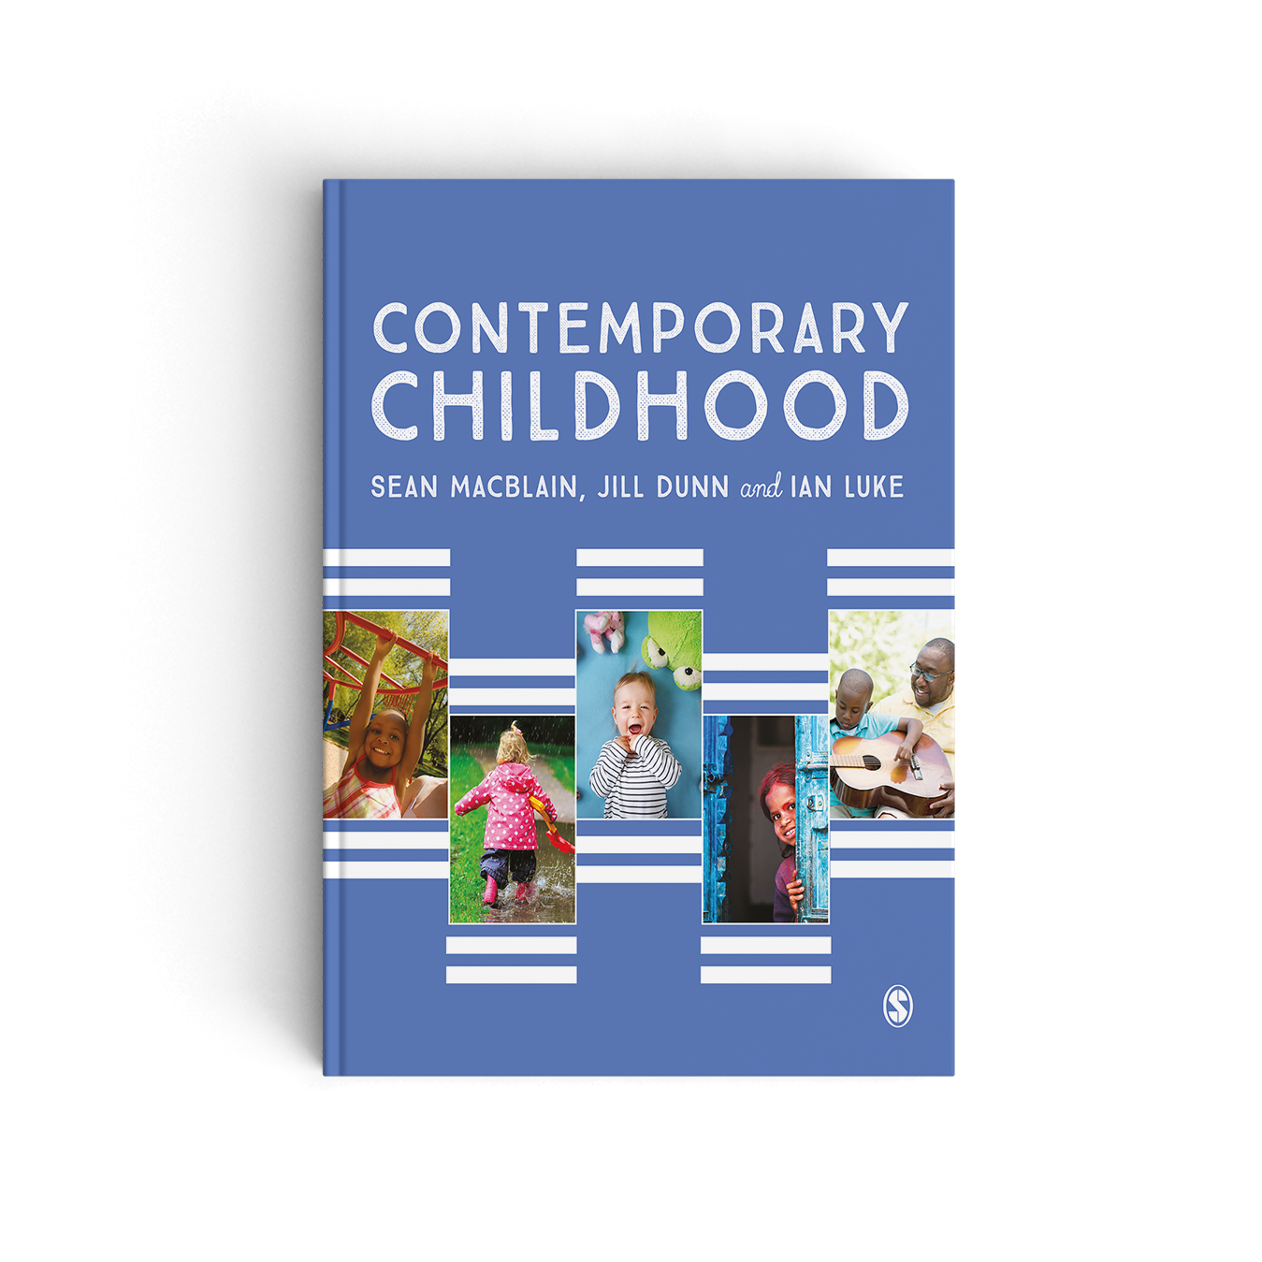
Chapter 6 The Parent’s Voice

Slide 2
Listening to parents
Parents will have unique insights into their children’s behaviours, feelings and emotions and will have detailed and important knowledge of those family and community cultures that their children have been born into.
Parents may find themselves at different stages of their children’s lives having to deal with issues that are health related, educational or psychological in nature. In such instances they may feel confused, misinformed and vulnerable. They may even feel unheard and alone and in more extreme cases, experience a sense of losing control to professionals, systems and processes that are unfamiliar to them and even frightening.

Slide 3
Parents’ working patterns
A further change that has impacted upon the lives of many children has been the increase in hours worked by their parents. This has led to growing demands on many parents who are now expected to manage increasingly busy lives as well as the increasing demands made upon them in their workplace.
Working patterns are changing the nature of family life and in many cases their children’s learning. This may be considered to be a good or bad thing depending upon the nature and quality of the experiences at home.
A recent study in the USA (Vittrup et al., 2016) explored parental attitudes towards media and the perceptions the parents had of their children’s knowledge and engagement with different media technologies. Though parents demonstrated positive attitudes toward media, ‘many disagreed with recommendations from expert sources regarding age-appropriate screen time’.

Slide 4
Provision for parents and children
The UK falls significantly behind most of the industrialized world in regard to maternal employment rates, reporting that with British mothers who’s youngest child is aged 3 to 5 years, average employment rates are around 58 per cent compared to that of 64 per cent across the industrialised world (Fitzgerald and Kay, 2016).
Fitzgerald and Kay have also emphasised how in Finland, children themselves are accorded an entitlement to provision – every child has a right to early childhood education and care from birth until the age of 7. In addition, children are given access to day care from birth until the age 6 usually within publically-subsidised private care or publically-funded day care settings. From the age of 6, Finnish children attend pre-school for one year during which they have a half day of early education followed by the remainder of the day in day care.

Slide 5
L Provision for parents and children
Traditionally, many parents in the UK have relied on relatives to look after their children while they work. This continues to remain the case in countries such as Ireland where a recent downturn in the economy has led to some parents struggling with the affordability of childcare and having to rely on relatives. Increasingly, many parents have grown to rely upon the services of childminders. The nature of childminding in the UK has, however, been changing dramatically over recent years with much greater emphasis being placed on relevant qualifications, increased monitoring of practice through inspection and a growing accountability and requirement to work more multi-professionally, which often involves working with other agencies and stakeholders (Brooker, 2016). The result has been a marked decline in registered childminders, which appears to offer few signs of slowing down.

Slide 6
References
Brooker, L. (2016) ‘Childminders, parents and policy: testing the triangle of care’, Journal of Early Childhood Research, 14(1) 69–83.
Fitzgerald, D. And Kay, J. (2016) Understanding Early Years Policy (4th edn). London: Sage.
Vittrup, B., Snider, S., Rose, K.K. And Rippy, J. (2016) ‘Parental perceptions of the role of media and technology in their young children’s lives’, Journal of Early Childhood Research, 14(1) 43–54.

