Slide 1
Writing, Reporting, and Contributing to the Literature
Chapter 11
Janet Salmons, PhD

Slide 2
Objectives
After reading and reflecting on Chapter 11, you will be able to:
Think through the options for reporting on the study, including scholarly and informal ways to disseminate it.
Use the qualitative eResearch framework to organize the report and self-assess it for completeness.

Slide 3
Not either/or: informal writing is now part of the publishing cycle and online ecosystem.
Peer-Reviewed Publishing
Social Media
Blogs
Share Process and Results

Slide 4
Types of Research Output
White et al. (2014) suggest four broad types of research output:
Comprehensive output includes substantive reports about the entire study, including methods, findings, and implications.
Summary findings provide a synthesis of key findings.
Developmental findings can be presented during the project to share your emergent findings or ideas.
Selective reports present themes or research elements for particular audiences.

Slide 5
Match Type of research output with channel
Comprehensive
Article
Book or chapter
Summary
Presentation
Online posts

Slide 6
Match Type of research output with channel
Developmental findings
Article
Online posts
Selective: for particular audience
Article or presentation
Online posts

Slide 7
Blogs in contrast to social media
Blogs
Social Networking Sites
Flexible formats & options
Open access
Features determined by author
Advertising or links determined by author
Formats determined by commercial owner of site
Registration/Log in
Features determined by commercial owner of site
Advertising or links determined by commercial owner of site

Slide 8
Research, Researchers & Blogs
How academics communicate directly using social media and blogs:
Researcher to researcher: sharing and exchange, within and across disciplines.
Researcher to participant: building credibility and ‘informing’ participants.
Researcher to audience: sharing findings, results and practical resources.

Slide 9
Types of academic Blogs
Solo | Collaborative | Multi-Author
Owner and guests | 2–10 authors and guests | Editorial team, professional editing, strong production values
Individual author’s identity | Topic or discipline identities | Strong branding, linked to university, media outlet or professional/scientific bodies or journals
(Adapted from Dunleavy, 2014)

Slide 10
Researcher to Researcher
Exchange & Networking
Resources
Plans & Events
Use informal exchange to share with peers and find new collaborative partners.

Slide 11
Researcher to Participant
Develop credibility
Recruit
Inform
Use informal online channels to create a scholarly online presence, find potential participants and inform them of inclusion criteria. During the study, describe the unfolding process and keep participants and stakeholders informed.

Slide 12
Researcher to Audience
Translate
Apply
Contribute
Translate scholarly language and formal results into usable tips or recommendations that can be applied in practice. Given that the public funds a great deal of research, this contribution is significant.

Slide 13
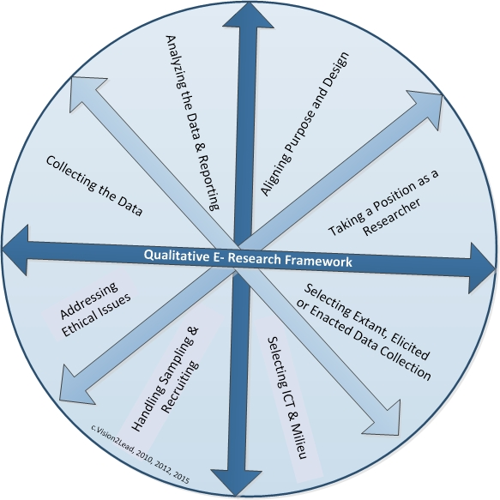
Writing, Reporting, & Contributing to the Literature
Think about sharing your research process as well as findings. One advantage of the thoughtful, holistic process described in the Qualitative eResearch Framework is that it gives you, not only food for thought, but also material to write about!

Slide 14
References
Dunleavy, P. (2014) Shorter, better, faster, free: Blogging changes the nature of academic research, not just how it is communicated.
White, C., Woodfield, K., Ritchie, J. & Ormston, R. (2014). Writing up qualitative research. In J. Ritchie, J. Lewis, C.M. Nicholls & R. Ormston (eds), Qualitative research practice: A guide for social science students and researchers (2nd edn). London: Sage.

