Slide 1
Elicing Data Online
Chapter 8
Janet Salmons, PhD

Slide 2
Objectives
After reading and reflecting on Chapter 8, you will be able to:
Distinguish between types of elicitation with individuals or groups.
Analyze ways in which each type might be employed to achieve the study purpose.
Understand the role(s) and position(s) of the researcher in planning and conducting research with consenting participants.
Consider how decisions made about the type of data collection relate to other design decisions for the online study.

Slide 3
What Does It Mean to Elicit Data?
At its simplest: researchers determine a research problem, purpose and question(s) that guide design decisions. To understand the research problem and address the research question, they look for participants who have experienced, observed or understand the problem. Using verbal or written questions, and/or verbal, written or visual prompts, the researcher encourages participants to respond.

Slide 4
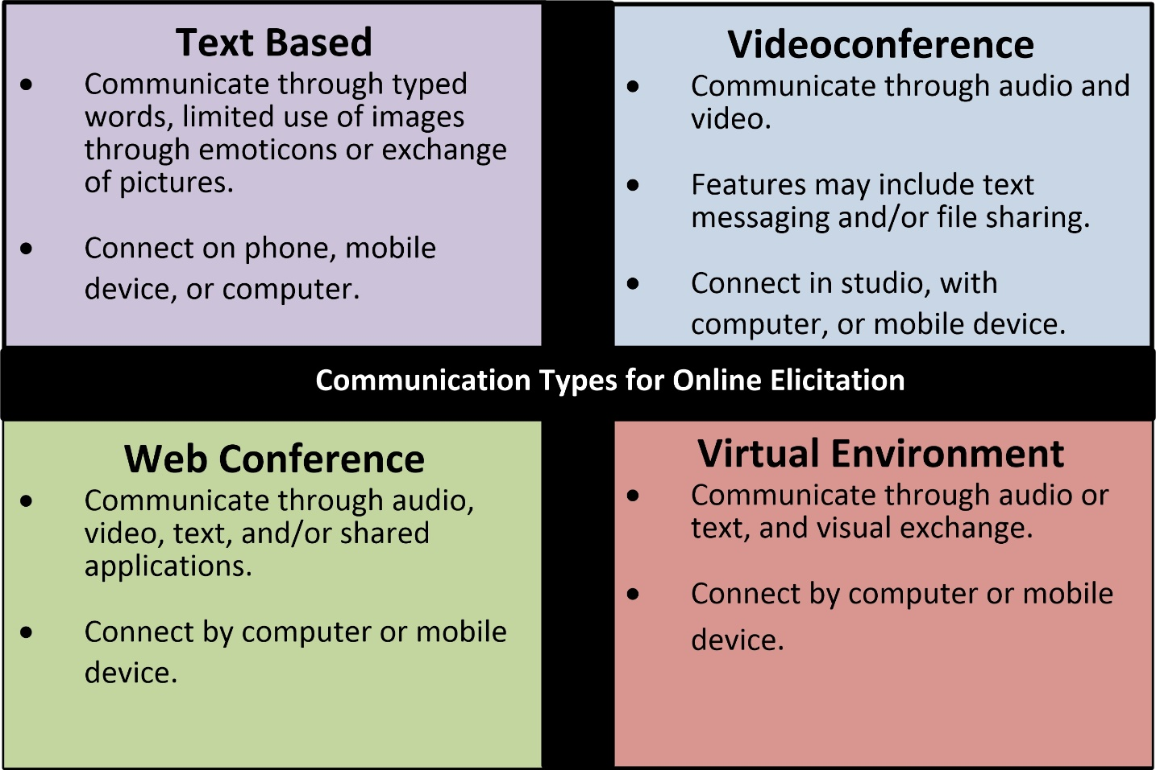
What Does It Mean to Elicit Data online?
Online elicitation in 1-1 or group interviews can occur through and with
a wide range of information and communications technologies (ICTs).

Slide 5
Think about the timing between question & response
To what extent is synchronous versus asynchronous exchange appropriate for the study? Why?
How might you combine different levels of synchronicity in the same study?

Slide 6
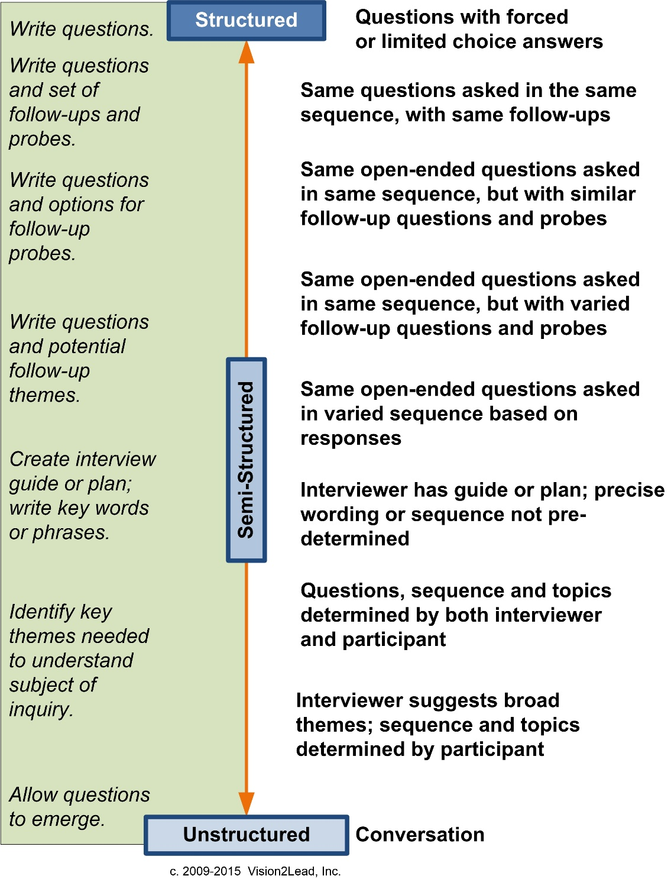
Collect data with Questions
Structured: All questions are articulated in advance.
Semi-structured: Main questions are articulated in advance, follow-up questions are determined during the interview when more details are needed.
Unstructured: Questions determined during the interview.
Typology of eInterview Structures

Slide 7
Preparing questions & Prompts
Research Question
Main Question
Follow-up Questions
Probes
Prompts
Main Question
Thematic questions relate to the ‘what’ of the interview and dynamic questions that pertain to the ‘how’ of an interview, and dynamic questioning refers to building rapport needed to keep the conversation flowing (Kvale, 2007). Follow-up questions ask participants to refine or deepen responses. Probes encourage the participant to continue the line of comments or redirect the participant into a new question (Rubin & Rubin, 2012).

Slide 8
The final word in preparation for data collection: Practice!
Practice interview skills using different technologies with your classmates, friends and family members. Use what you learn to choose the most appropriate communication medium for the study.
Practice asking structured, semistructured and/or unstructured questions. Use what you learn to choose the most appropriate types of question(s) for the study.
Practice asking follow-up and probing questions.

Slide 9
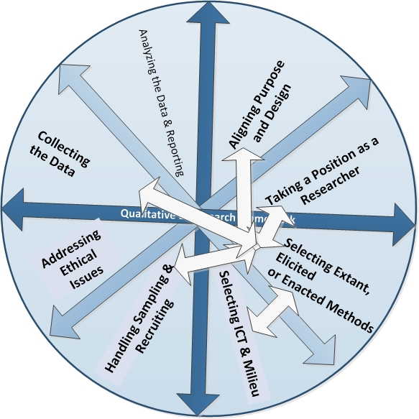
Collecting Data Online & the Qualitative eResearch framework
While the researcher may be deeply engaged with the activities associated with data collection, it is important to remember how this phase fits into the overall inquiry.

Slide 10
References
Kvale, S. (2007) Doing interviews. Thousand Oaks, CA: Sage.
Rubin, H.J. & Rubin, I.S. (2012) Qualitative interviewing: The art of hearing data (3rd edn). Thousand Oaks, CA: Sage.

