Slide 1
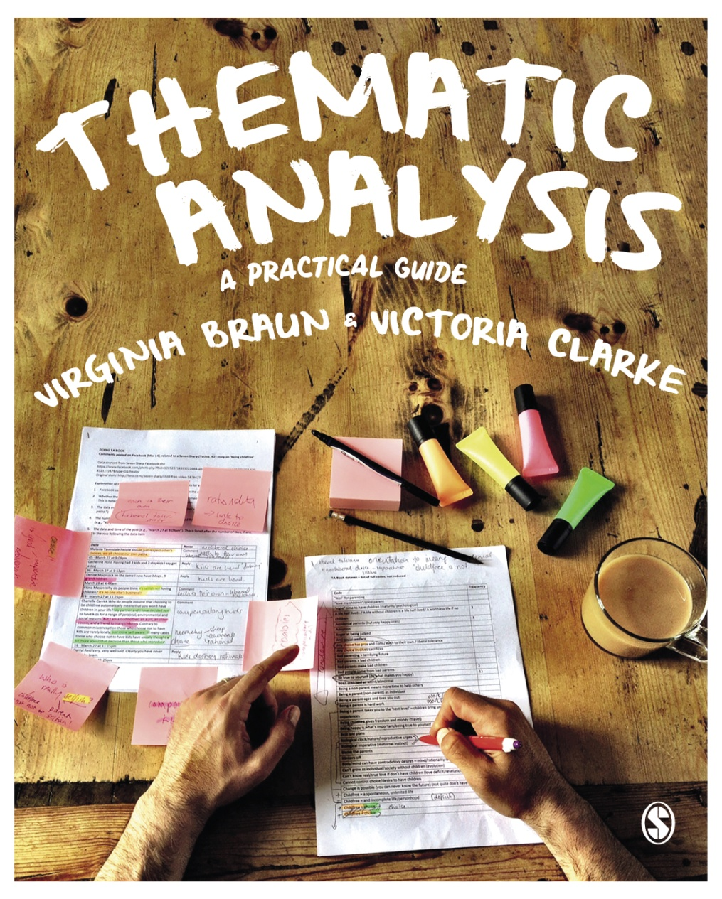
Thematic Analysis © Virginia Braun, Victoria Clarke

Slide 2
Activities not connected to specific datasets
For teaching undergraduate and postgraduate students in the classroom

Slide 3
Activities list
Getting started with familiarisation (relates to Chapter Two)
Evaluating analytic claims activity (activity from Chapter Five)
Theoretical assumptions activity (activity from Chapter Six)
Theoretical detection (activity from Chapter Six)
Critically evaluating the account of TA in a published study (activity from Chapter Eight)
Critically evaluating a published ‘reflexive thematic analysis’ study (activity from Chapter Nine)

Slide 4
1. Getting started with familiarisation
Familiarisation involves dual processes of:
Developing deep and thorough knowing of the content of your dataset, along with
Critical engagement to start the analytic engagement.
With familiarisation you move from just ‘taking in’ data content to starting to make sense of what might be going on with the dataset.
Thinking about ‘asking questions of the dataset’ can be a useful way ‘in’ to these critical engagement processes…

Slide 5
Questions to ask your data that aid familiarisation
Imagining a dataset of ‘talk data’ (eg interview data), we offer some questions to get you started (this is not exhaustive and won’t suit all data or research questions); add your own!
How does the person make sense of whatever it is they are discussing?
Why might they be making sense of things in this way (and not in another way)?
In what different ways do they make sense of the topic?
How ‘common-sense’ or socially normative is this depiction or story?
How would I feel if I was in that situation? (Is this different from or similar to how the person feels, and why might that be?)
What assumptions do they make in describing the world?
What kind of world is ‘revealed’ through their account?

Slide 6
Questions to ask yourself to aid familiarisation
As well as ‘reading’ the data, reflexive TA requires us to ‘read’ our own engagement with our data and research (and to interrogate it).
Questions to ask yourself include:
Why might I be reacting to the data in this way?
What ideas does my interpretation rely on?
What different ways could I make sense of the data?
Keep notes of what you observe and questions you might have through this familiarisation process.

Slide 7
2. Evaluating analytic claims in reflexive TA research(1 of 3)
Identify a reflexive thematic analysis paper
or example, this one on disability disclosure at university: Blockmans, I. G. E. (2015). “Not wishing to be the white rhino in the crowd”: Disability-disclosure at university. Journal of Language and Social Psychology, 34(2), 158–180.
Read the paper, and focus specifically on how the methodology and process is described, and the analysis is reported (the claims they make)

Slide 8
2. Evaluating analytic claims in reflexive TA research(2 of 3)
Evaluate the authors’ methodological description, and then their analytic claims. Specifically, reflect on the following:
Does the methodological description give you confidence in their analytic process?
Do the analytic claims and interpretation seem defensible?
Does the author (or authors) locate their analysis in relation to the wider context and/or in terms of existing empirical or theoretical scholarship?
Do the analytic claims resonate with you – do they evidence some naturalistic generalisability (where readers make connections between a reported analysis and their own experiences)? If so, why?

Slide 9
2. Evaluating analytic claims in reflexive TA research(3 of 3)
Has the author (or authors) done a good job of providing some kind of thick description around interpretation, or providing a detailed locating of the sample, so that the specificity/transferability of the results can be assessed? Would you feel confident that you know enough about how the sample or context might differ from your own location to make any claims about how the analysis might apply in or be transferred to your context?
What sorts of wider claims – beyond the specifics of the dataset – does the author (or authors) make? Do you find these claims compelling? Why or why not?

Slide 10
3. Theoretical assumptions in research – a reflexive activity(1 of 3)
Think about who you are as a researcher, and the assumptions and perspectives you bring to the research process, particularly about the fundamental questions of the nature of human existence and the structure of reality (Crotty, 1998), and how we can create meaningful knowledge about the world.
Try to identify your assumptions about human existence, reality and knowing. Reflect on, and write notes on, the following questions:
Crotty, M. (1998). The foundations of social research: meaning and perspective in the research process. Sage.

Slide 11
3. Theoretical assumptions in research – a reflexive activity(2 of 3)
Why does research matter? What is its purpose?
What is the nature of reality? Do you think there is an objective and singular reality that exists independent of our minds, our ways of knowing it? Or do you think realities are created in and through human practices?
What is the researcher’s role in the research process? Do you think they discover or harvest meaning or play an active role in meaning creation?

Slide 12
3. Theoretical assumptions in research – a reflexive activity(3 of 3)
How best can we generate knowledge about the world? Should we strive for objectivity, or view subjectivity as a strength?
What role do the researcher’s values play in the research process?
Following this, try to determine what ontology and epistemology best reflects the answers you gave to these questions. Does that surprise you? How do you feel about this? What would holding these positions mean for research practice in thematic analysis, and the sorts of knowledge you could generate?

Slide 13
4. Theoretical detection exercise(1 of 2)
Find a recently published thematic analysis paper in your discipline or field of research (or use one of the papers made available for this exercise on the companion website).
Try to identify the philosophical meta-theoretical assumptions informing the paper. In doing this, consider those explicitly acknowledged by the authors, and those you can ‘detect’ from reading the paper.
Note. that these detected assumptions might contradict the explicitly acknowledged assumptions.

Slide 14
4. Theoretical detection exercise(2 of 2)
Broadly speaking, try to determine:
If the paper is realist, critical realist or relativist? Postpositivist, contextualist or constructionist?
If the theory of language informing the data analysis is reflective, intentional or constructionist?
If the paper is an example of experiential or critical thematic analysis?
Is there any evidence of confusion around Big Theory?
From this exercise, do you think the paper offers a theoretically coherent use of thematic analysis?

Slide 15
5. Critical evaluating the account of thematic analysis in published research(1 of 3)
Find a paper that reports on data analysis with thematic analysis. Feel free to choose your own (or select one of these two, available on the companion website):
For beginners to critically evaluating published thematic analysis, we suggest: Buchanan, K., & Sheffield, J. (2017). Why do diets fail? An exploration of dieters’ experiences using thematic analysis. Journal of Health Psychology, 22(7), 906-915.
For a more challenging evaluation activity, we suggest: Matthews, E. J., & Desjardins, M. (2017). Remaking our identities: Couples’ experiences of voluntary childlessness. The Family Journal, 25(1), 31-39.

Slide 16
5. Critical evaluating the account of thematic analysis in published research(2 of 3)
Determine whether a particular form of thematic analysis (coding reliability, codebook or reflexive) is used and cited, or not. Or is there evidence of some ‘mash-up’ of different approaches to thematic analysis? If a mash-up, is this explicitly acknowledged and discussed?
Identify how the authors conceptualised codes/coding and themes, based both on what they said about them (if anything), and what they actually did in the analysis.

Slide 17
5. Critical evaluating the account of thematic analysis in published research(3 of 3)
Identify how the authors handled the question of researcher subjectivity.
Having critically evaluated the method of the paper – how was thematic analysis conceptualised and used and reported?
Decide whether you think this paper offers an example of Big Q, medium Q or small q (or, indeed confused q) qualitative research. Explain why you think that is.

Slide 18
6. Critically evaluating a published ‘reflexive thematic analysis’ study – brief exercise overview(1 of 3)
Find a recent example of thematic analysis claiming to use reflexive thematic analysis, or specifically Braun & Clarke (2006), from your field of study (or use one of the two we offer below – available on the companion website):
Marcu, A., Gaspar, R., Rutsaert, P., Seibt, B., Fletcher, D., Verbeke, W., & Barnett, J. (2015). Analogies, metaphors, and wondering about the future: Lay sense-making around synthetic meat. Public Understanding of Science, 24(5), 547-562.
Toft, A., Franklin, A., & Langley, E. (2020). ‘You’re not sure that you are gay yet’: The perpetuation of the ‘phase’ in the lives of young disabled LGBT+ people. Sexualities, 23(4), 516–529.

Slide 19
6. Critically evaluating a published ‘reflexive thematic analysis’ study – brief exercise overview(2 of 3)
Using Tables 9.1 and 9.2 from Thematic Analysis: A Practical Guide to guide you, critically evaluate your chosen paper to identify:
Any problems
Instances of good practice.
Considering the balance between any problems and good practice, how would you assess the paper as an example of reflexive thematic analysis?
In evaluating the balance between ‘problems’ and ‘good practice’, what was most important in determining your overall assessment of the paper, and why?

Slide 20
6. Critically evaluating a published ‘reflexive thematic analysis’ study – brief exercise overview(1 of 3)
If you are part of a group, you could do this individually and then compare your assessments in a shared discussion session.

