Slide 1
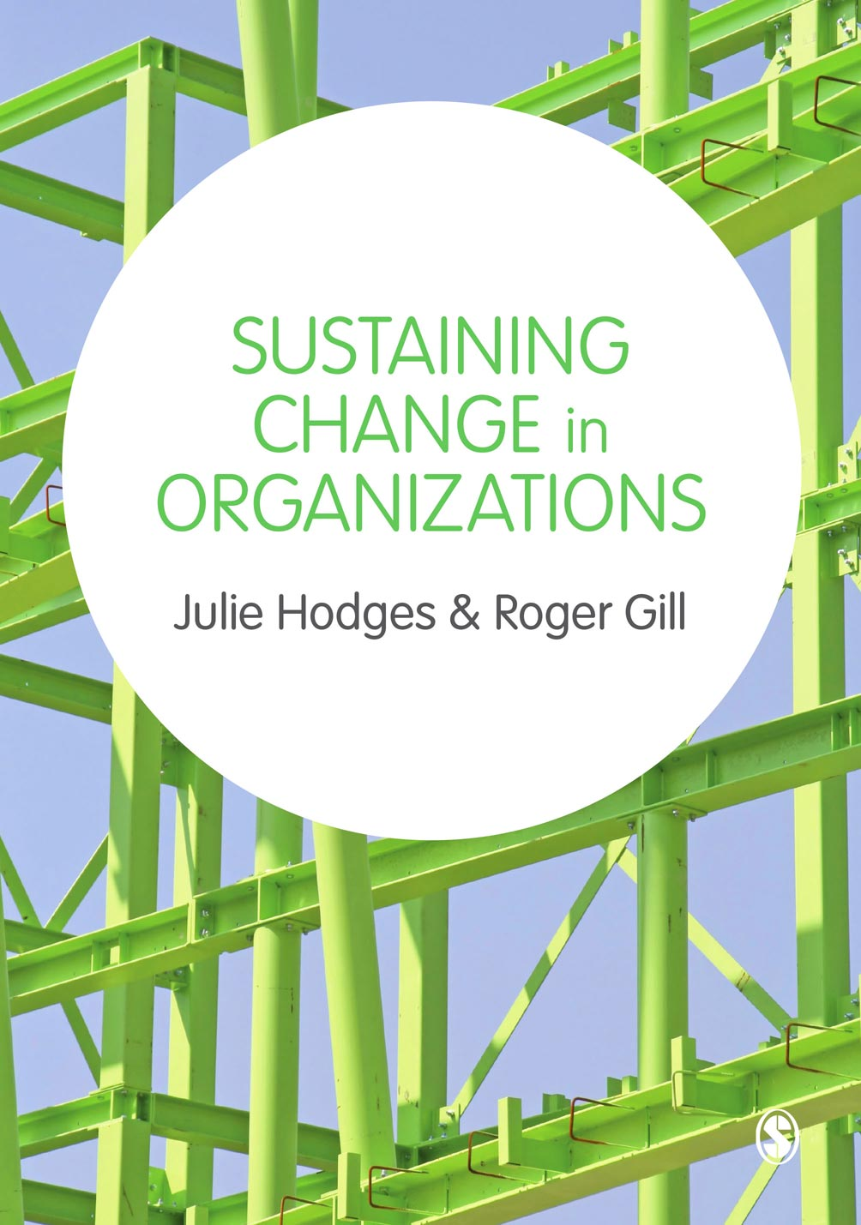
© Julie Hodges and Roger Gill

Slide 2
Chapter 10 Communication and Change
© Julie Hodges and Roger Gill

Slide 3
Learning Outcomes
Appreciate the importance of communication during times of change
Outline the elements of the communication process
Develop relevant communication strategies
Identify the key elements of a communication plan
© Julie Hodges and Roger Gill

Slide 4
The communication process
Communication – the transference and understanding of meaning
(Robbins et al 2010)
© Julie Hodges and Roger Gill

Slide 5
‘Only messages can be sent and received; meanings cannot be transmitted. This means that senders of messages must encode their meanings into symbols, choosing those that are likely to be familiar to their audience’ (Guirdham 2005: 89)
© Julie Hodges and Roger Gill

Slide 6
The communication process
Encoding – sender’s translation of idea into a form which can be recognised by a receiver
Transmission via communication channels – of which there are many
Decoding – process whereby a receiver perceives a sent message and interprets its meaning
Feedback – whereby the sender and receiver exchange roles so that the receiver responds to the message
Noise – factors of distortion
© Julie Hodges and Roger Gill

Slide 7
Communication plays a vital role in the change process
Clampitt et al. (2000) suggest that communication strategies often emerge from existing practices with little hard thinking about communication objectives or processes.
© Julie Hodges and Roger Gill

Slide 8
Communication Strategies
High
Underscore & Explore
Tell & Sell
Identify & Reply
Communication effectiveness
Spray & Pray
Withhold & Uphold
Low
Great
Amount of information transferred
Little
Clampett et al’s (2000)
© Julie Hodges and Roger Gill

Slide 9
Organizational silence (Morrison & Milliken, 2000)
The widespread withholding of information can:
deprive decision makers of the opportunity to consider alternative perspectives
inhibit organizational learning because it affects the ability of managers to detect and correct the causes of poor performance
© Julie Hodges and Roger Gill

Slide 10
In pairs
Discuss how the need for change is communicated in your organization.
Is it communicated to everyone affected by the change? If not, who is left out?
Identify how communication about change be improved?
© Julie Hodges and Roger Gill

Slide 11
Communication supports change but proactive integrated communication accelerates successful change
Guiding Team
How will we mobilise our leaders?
Get the Vision right
What’s our vision and change story?
Increase urgency
How will we manage the change?
Communicate for Buy-In
How will we energise stakeholders and secure buy-in?
INTEGRATED
CHANGE
COMMUNICATION
Make the Change Stick
How will we configure ourselves to achieve our business goals?
Empower Action
How will our people processes be aligned to support the change?
Don’t Let up
How will our vision and environment encourage desired behaviours?
Create Short term wins
What’s in it for the company and for me?
© Julie Hodges and Roger Gill

Slide 12
The change communications process
1. Explaining
the Need
2. Clarifying the Vision
3. Inspiring for
Action
4. Sustaining
Momentum
Step 1: Explain the Need
Announce the change
Give compelling business reasons for the change
Begin to motivate people to change
Step 2: Clarifying the Vision
Focus on 2 way communication
Allow for resistance & questioning
Step 3: Inspiring for action
Build on current awareness
Motivate people to let go of the old way of doing things
Influence people to accept new way of doing things
Step 4: Sustaining momentum
Reinforce the changes
Promote the internalisation of new behaviours
Encourage sustained acceptance and internalisation of new culture
© Julie Hodges and Roger Gill

Slide 13
Communications Plan
 | Audience 1 | Audience 2 | Audience 3 | Audience 4
Objectives
Desired Outcome
Key Methods
Distribution Methods & Channels
Frequency
Responsibility For Preparation & Delivery
Key Impact & Feedback Measures
© Julie Hodges and Roger Gill

Slide 14
Summary
Communication is integral to sustaining change.
Communication is an ongoing activity and should be adapted to the nature and stage of the change. The methods, messages, audiences and feedback are all vital parts of the communication process during change.
Communication enables leaders and managers of change to create a shared sense of direction, purpose and values, establish strategies, plans and priorities, reduce uncertainty, build trust, and empower and engage people in doing what needs to be done.
© Julie Hodges and Roger Gill

Slide 15
References
Clampitt, P., DeKoch, R., Cashman, T. (2000) ‘A strategy for communicating about uncertainty’, Academy of Management Executive, 14(4): 41-57.
Robbins, S.P., Judge, T.A. and Campbell, T.T. (2010) Organizational Behaviour. Harlow: FT/Prentice Hall.
© Julie Hodges and Roger Gill

