Slide 1
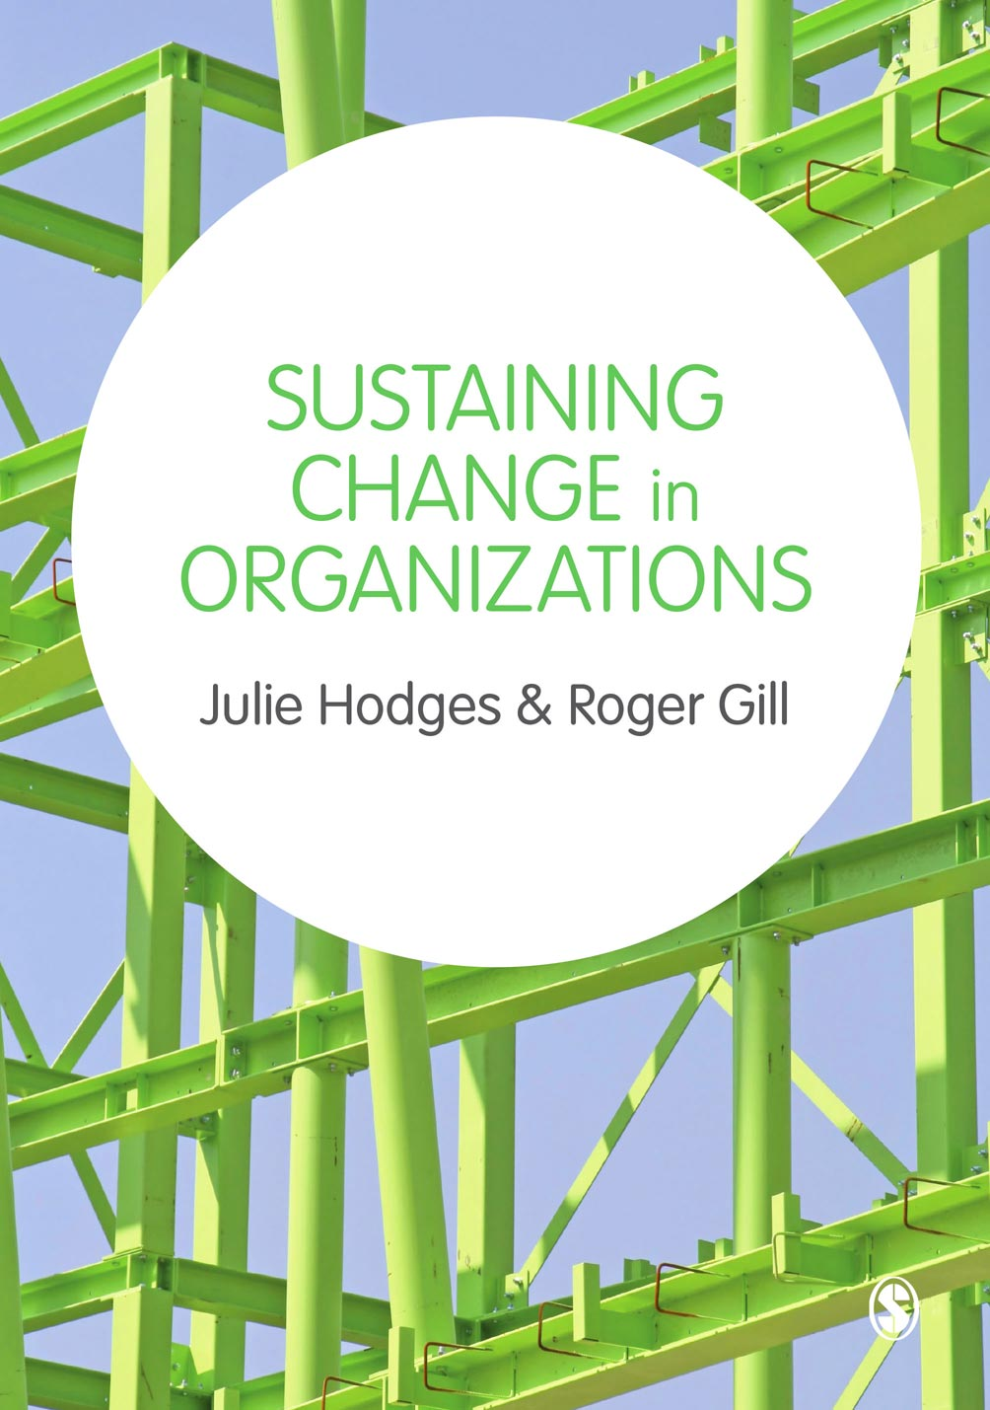
© Julie Hodges and Roger Gill

Slide 2
Chapter 13 Ensuring Sustainable Change and Transformation through Monitoring and Measurement
© Julie Hodges and Roger Gill

Slide 3
Learning outcomes
To identify the factors that contribute to measuring and monitoring organizational change and transformation
To apply techniques for sustaining change
To describe the pitfalls that can be encountered when seeking to sustain change
To identify the benefits and risks of change
To measure the impact of change
© Julie Hodges and Roger Gill

Slide 4
Measuring the impact of change
Establish a clear aim
Define the key measures
Collect baseline data
Collect data consistently
Chart progress
Ask questions
© Julie Hodges and Roger Gill

Slide 5
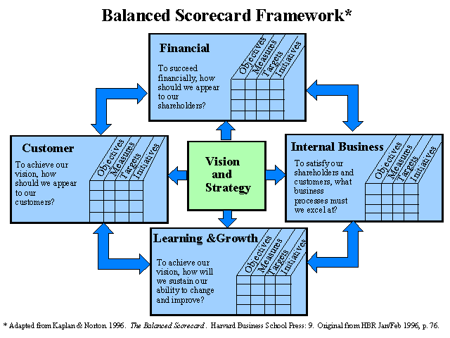
Balanced Scorecard objectives, measures, targets and initiatives (Adapted from Kaplan and Norton (1996) ‘The Balanced Scorecard’, Harvard Business Review, January/February, p.76)
© Julie Hodges and Roger Gill

Slide 6
Benefits realization
© Julie Hodges and Roger Gill

Slide 7
Reasons for identifying benefits at the start of the process
Benefits are identified, measured and the process is locked in from the start.
The business case for change is identified in a quantifiable way.
The reason for change is clear; the benefits provide a focus for everyone.
Return on investment in change can be measured.
Success can be identified, recognized and celebrated, thereby having a positive impact on future change initiatives.
There is clear agreed accountability for sustaining change.
Progress can be tracked, monitored, and delivered.
Stakeholders are clear about both current and expected performance.
The credibility of the change is enhanced through realization and recognition of the benefits.
The cost of implementation is calculated, understood and monitored.
© Julie Hodges and Roger Gill

Slide 8
Realizing benefits
Engaging stakeholders
Developing the business case
Identifying risks
Developing a tracking mechanism
Tracking benefits
Communicating achievement of benefits
Monitoring and reviewing benefits realization
© Julie Hodges and Roger Gill

Slide 9
Reasons for managing risks
To reduce or eliminate where possible the impact of a risk that has occurred.
To increase the chance of success of change(s).
To reduce or eliminate where possible the probability of a risk occurring.
To reduce or eliminate where possible the financial impact of a risk that has occurred.
To Increase the visibility of risks to management and other staff.
To secure successful continuity and profitability.
To secure a stable working-environment for staff.
© Julie Hodges and Roger Gill

Slide 10
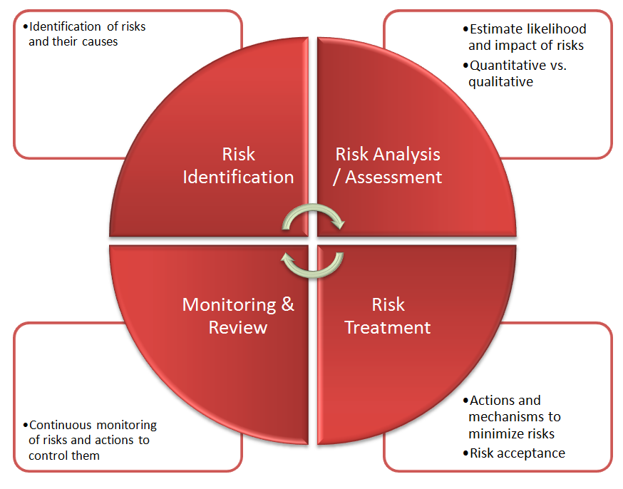
Managing Risks (Adapted from www.securityresearch.at Trends in Project Risk)
© Julie Hodges and Roger Gill

Slide 11
Identifying risks
External risks
- External risks are outside the control of managers. Egs include government regulatory changes, new products and services from competitors, A&Ms, disasters such as floods, earthquakes.
Cost risks
- Risks which are directly or indirectly under control of manager. Egs cost overuns by project teams; scope creep, poor estimating or errors that result in unforseen costs, overruns on budgets and schedules
Technology risks
- result from a wide variety of circumstances. Typical examples are problems with immature technology, use of the wrong tools, software that is untested or fails to work properly, requirement changes with no change management, failure to understand or account for product complexity, integration problems, and software/hardware performance issues (poor response times, bugs and errors.).
Operational risks
- Operational risks can result in a failure to realize the intended or expected benefits of the project. Typical causes are inadequate resolution of priorities or conflicts, failure to designate authority to key people, insufficient communication or lack of a communication plan, and rollout and implementation risks – ‘too much, too soon’.
© Julie Hodges and Roger Gill

Slide 12
Mitigating risks
Avoid.
- Counter-measures are put into place that either stop the threat or problem from occurring or prevent it from having any impact upon the change.
Transfer.
- A specialist form of risk reduction, where the impact of the risk is passed on to a third party via, for instance, an insurance policy or penalty clause, albeit at a cost.
Mitigate.
- Where the response actions either reduce the likelihood of the risk developing or, if the risk occurs, limit the impact on the change to acceptable levels.
Accept.
- There is acceptance of the possibility that the risk might occur.
© Julie Hodges and Roger Gill

Slide 13
Approaches for monitoring change
Feedback
Survey
Review the implementation plan
Review the communications
Monitor how people are responding emotionally
Performance management
© Julie Hodges and Roger Gill

Slide 14
Factors for sustaining change in organizations
Be aware of the drivers for change
Diagnose the need and readiness for change
Plan and implement change
Identify and implement relevant interventions
Communicate
Identify and manage the impact of change on people
Monitor and measure
Manage and lead change …
© Julie Hodges and Roger Gill

Slide 15
Summary
Measuring and monitoring change is a key element to successfully sustaining change.
Benefits should be identified at the start of a change process and monitored throughout in order to ensure they are realized.
Risks need to be identified, mitigated and reviewed throughout a change process.
© Julie Hodges and Roger Gill

