Slide 1
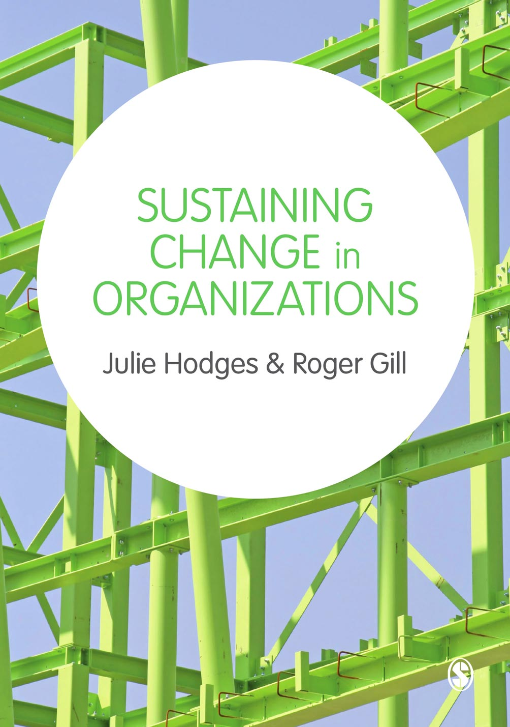

Slide 2
Chapter 2 Theoretical Approaches to Change and Transformation
© Julie Hodges and Roger Gill

Slide 3
Learning outcomes
Explain the complex nature of change in organizations
Discuss the theoretical perspectives relating to the types of change that organizations experience
Critically examine the different types of change
© Julie Hodges and Roger Gill

Slide 4
Agenda
The nature and impact of change
Theories of change
Implications of different types of change
© Julie Hodges and Roger Gill

Slide 5
Populist view
© Julie Hodges and Roger Gill

Slide 6
Change
Who moved my cheese? (Johnson, 2002)
Over 12 million copies sold
‘One of the most successful business books ever’ Daily Telegraph
© Julie Hodges and Roger Gill

Slide 7
Academic view
© Julie Hodges and Roger Gill

Slide 8
Change is a complex and ‘untidy cocktail’ of
rational decisions, mixed with competing
individual perceptions, stimulated by
visionary leadership, spiced with ‘power
plays’ and attempts to recruit support and
build coalitions behind a particular idea.
Pettigrew (1985)
© Julie Hodges and Roger Gill

Slide 9
Change: content & process
Barnett & Carroll (1995)
Organisational change should be conceptualised in terms of both content and process:
Process – how change occurs (speed, sequence of activities, decision making and communication systems)
Content – what actually changes in the organisation (many elements of structure or radical shift in a single element)
© Julie Hodges and Roger Gill

Slide 10
What is change?
Content
Process
© Julie Hodges and Roger Gill

Slide 11
Theories of change

Slide 12
The nature of change
Incremental vs radical
Continual vs episodic
Incremental vs transformational

Slide 13
Punctuated equilibrium
© Julie Hodges and Roger Gill

Slide 14
Components of punctuated equilibrium paradigm
Deep structure
Equilibrium period
Revolutionary period
(Gersick, 1991)

Slide 15
Theory O and E
Theory E
Theory O
(Beer & Nohria, 2000 ‘Cracking the code of change’, HBR)

Slide 16
Planned and Emergent Change
© Julie Hodges and Roger Gill

Slide 17
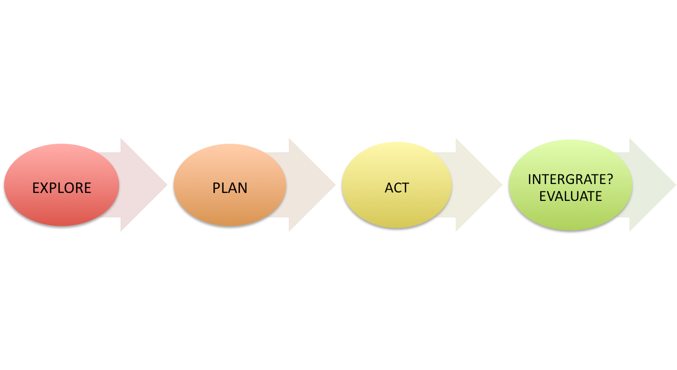
Planned change
© Julie Hodges and Roger Gill

Slide 18
Planned change
Unfreezing the restraining forces that maintain the status quo
Moving the organisation to a new state
Refreezing to consolidate the change
(Lewin, 1947)

Slide 19
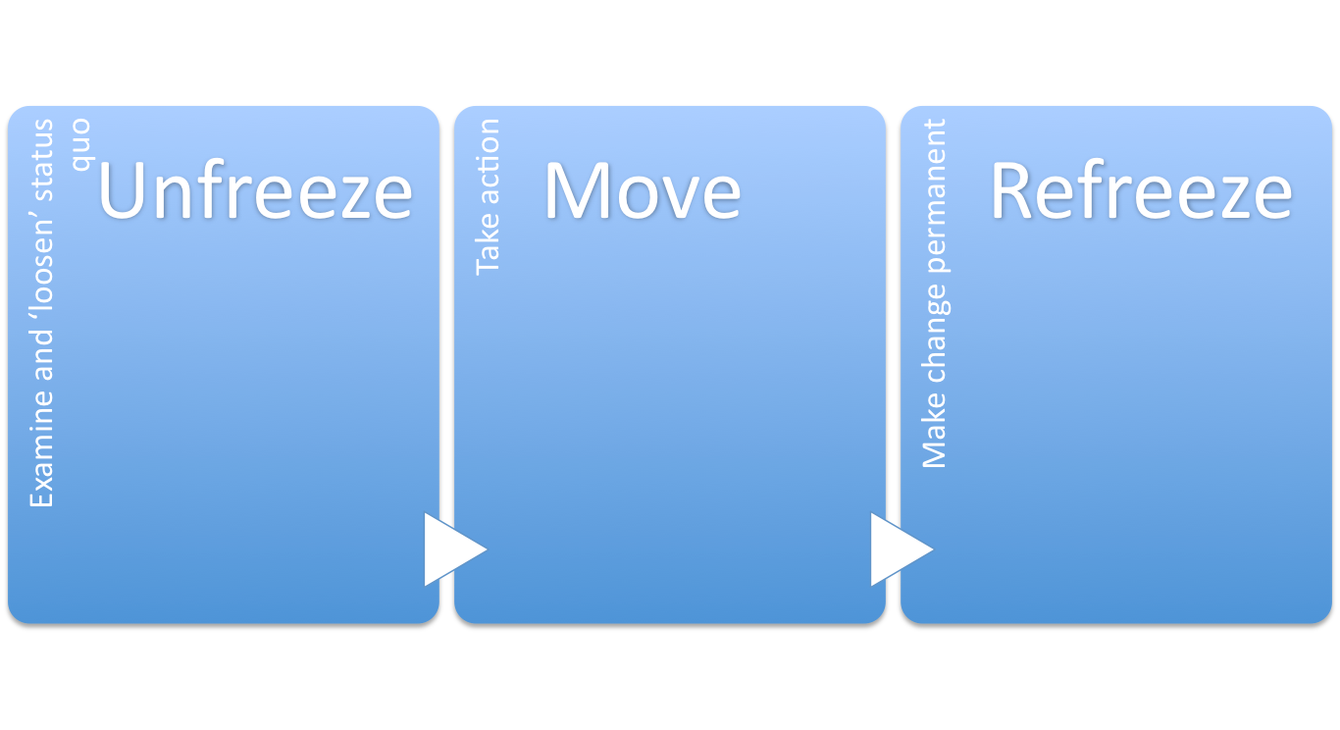
Lewin’s model
© Julie Hodges and Roger Gill

Slide 20
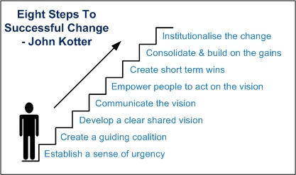
Kotter’s (1996) eight step model
© Julie Hodges and Roger Gill

Slide 21
Is change a neat, rational and linear process?

Slide 22
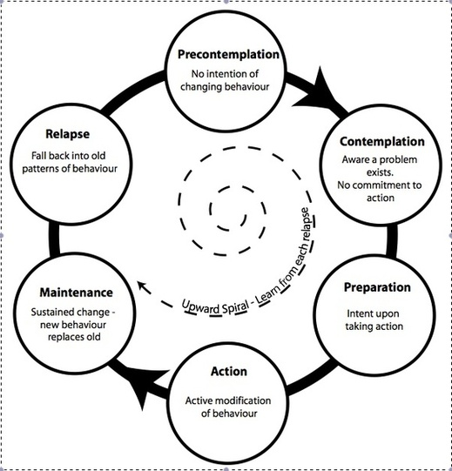
Prochaska & DiClemente’s model of change
© Julie Hodges and Roger Gill

Slide 23
Emergent change
Change is viewed as an ongoing process.
Change emerges from the actions and decisions of people in organizations.
(Weick, 2000)

Slide 24
Typology of change
How change happens Planned Emergent Contingency | Magnitude Incremental Transformational Punctuated Equilibrium
Focus Strategic Operational | Level Individual Team Organization

Slide 25
Summary
The nature of change depends on the context in which an organization is operating.
The typology of change includes how change happens, its magnitude, focus and the level.
A people and process driven approach to change (Theory O and Theory E) can be more effective than an either/or approach.
Change is not a neat, linear, rationale process.

Slide 26
References
Barnett, W. and Carroll, G. (1995) ‘Modelling Internal Organizational Change’, Annual Review of Sociology, 21: 217-36.
Kotter, J. (1996) Leading Change. Boston: Harvard Business School Press.
Lewin, K. (1947) ‘Frontiers in group dynamics: concept, method and reality in social science; social equilibria and social change’, Human Relations, 1(2): 143-153.
Pettigrew, A. (1985) The awakening giant. Oxford: Blackwell.
Weick, K. (2000) ‘Emergent change as a universal in organisations’, in M. Beer and N. Nohria (eds), Breaking the Code of Change. Boston, MA: Harvard Business Review Press.

