Slide 1

© Julie Hodges and Roger Gill

Slide 2
Chapter 4
Managing Change
© Julie Hodges and Roger Gill

Slide 3
‘The art of progress is to preserve order amid change, and to preserve change amid order.’
Alfred North Whitehead (1929), British mathematician and philosopher

Slide 4
Learning objectives
To distinguish between leading change and managing change and relate them to each other in explaining effective organizational change
To explain why change initiatives so often fail or fall short because of poor management
To explain what is meant by ‘strategies for change’
To produce a model of change management
To explain the competencies required for managers to carry out change initiatives successfully
To explain the ethical and moral issues that arise in change initiatives and how they may be resolved
To use learning opportunities to manage change effectively according to best practice
To use the information and ideas in this chapter to manage organizational changes effectively or to contribute to the effective management of change initiatives and programmes in an organization
© Julie Hodges and Roger Gill

Slide 5
What managing sustainable change entails
Change management is complementary to the leadership of change and, together with leadership, is necessary for effective and sustainable change
Many surveys and studies show examples of poor change management and how it can be improved
Potential improvements include more effective conceptualization of change, commitment to it (top down), communication, planning, organization, direction, implementation, monitoring and control; adequate resources; and compatible culture and other business practices
© Julie Hodges and Roger Gill

Slide 6
The role of managers in the change process
Change is a constant in today’s workplaces, so managers, not HR or consultants, should handle change themselves
While change leaders show the way and enable change to happen, managers can be said to make it happen
To do this effectively, managers need training and development
© Julie Hodges and Roger Gill

Slide 7
Key aspects of managing change
The purpose of managing change
Managerial responses to the ability and willingness of people to adapt
Understanding and using theories of change management
Structural and process elements
Political considerations
© Julie Hodges and Roger Gill

Slide 8
Cause and effect in change attitudes and behaviour (Bordia et al., 2011)
© Julie Hodges and Roger Gill

Slide 9
Managing the emotions and politics involved in change
Map the political landscape of who will be affected by change
Identify the key influencers – those who have the skills and interest to influence and convince others of the benefits of change – within each stakeholder group
Assess influencers’ receptiveness to change
Mobilize influential sponsors and promoters – those who have the skills, connections and insights to champion change
Engage influential positive and negative sceptics
Auster and Ruebottom (2013)
© Julie Hodges and Roger Gill

Slide 10
Dynamic Capability Theory (DCT) and managing change
DCT addresses change management strategy
‘Dynamic capability’ is the ability to create, extend or modify the resource base to respond to a rapidly changing environment
Three processes are required: coordination, learning, and strategic competitive response
Dynamic capabilities are antecedents to functional competencies for managing change
© Julie Hodges and Roger Gill

Slide 11
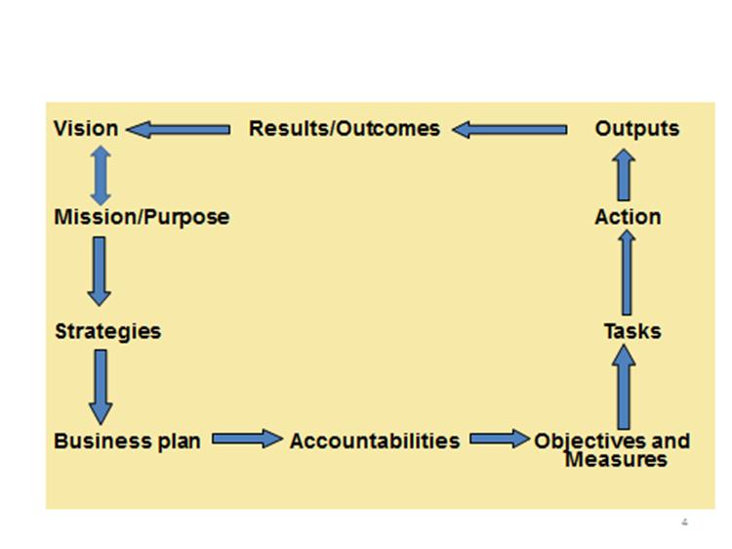
Management: turning vision and purpose into reality
© Julie Hodges and Roger Gill

Slide 12
The ASTD model of change management (2013)
Establishing sponsorship and ownership for change
Building involvement
Creating a contract for change
Conducting diagnostic assessments
Providing feedback
Facilitating strategic planning for change
Supporting the change intervention
Encouraging integration of change into organizational culture
Managing consequences
Evaluating change results
© Julie Hodges and Roger Gill

Slide 13
Benefits Realisation Management (BRM)
A clear framework providing a common language and a route map to follow
Available staff resources with the relevant skills, tools and techniques
A clear and consistent of the nature of the benefits, defined in detail at the outset and agreed within the business
Performance management using accurate, timely data
A clear strategic linkage shaping the change programme to ensure the business strategies are delivered
Full engagement by the change programme with the business, facilitated by a business change manager
Moorhouse Consulting (2012)
© Julie Hodges and Roger Gill

Slide 14
Perceived determinants of success in change initiatives*
© Julie Hodges and Roger Gill

Slide 15
Key attributes of change managers
(Caldwell, 2003)
© Julie Hodges and Roger Gill

Slide 16
Change entails risk, risk entails mistakes
Errors, mistakes and failures are more likely in change efforts than in routine work
To punish them is dysfunctional: they are a great source of learning and development
Where they are not critically important they should be tolerated, even welcomed, for this reason
A blame-free, learning culture is necessary for successful and sustainable change
© Julie Hodges and Roger Gill

Slide 17
Ethical aspects of managing change
Ethical and socially responsible change contributes to the well-being of all organizational stakeholders and society at large
This means ensuring that the intentions, goals, measures, processes, actions, outcomes and consequences of change are ethical and socially responsible
Education and training play an important part
© Julie Hodges and Roger Gill

Slide 18
Developing effective change managers
Organizational change programmes may have varied impact in different parts of the organization owing to their different contexts and sub-cultures
Education and training for change should focus at once on a few critical behaviours only
Coaching and mentoring, with ‘power questioning’, and experiential learning exercises are valuable tools
© Julie Hodges and Roger Gill

