Slide 1
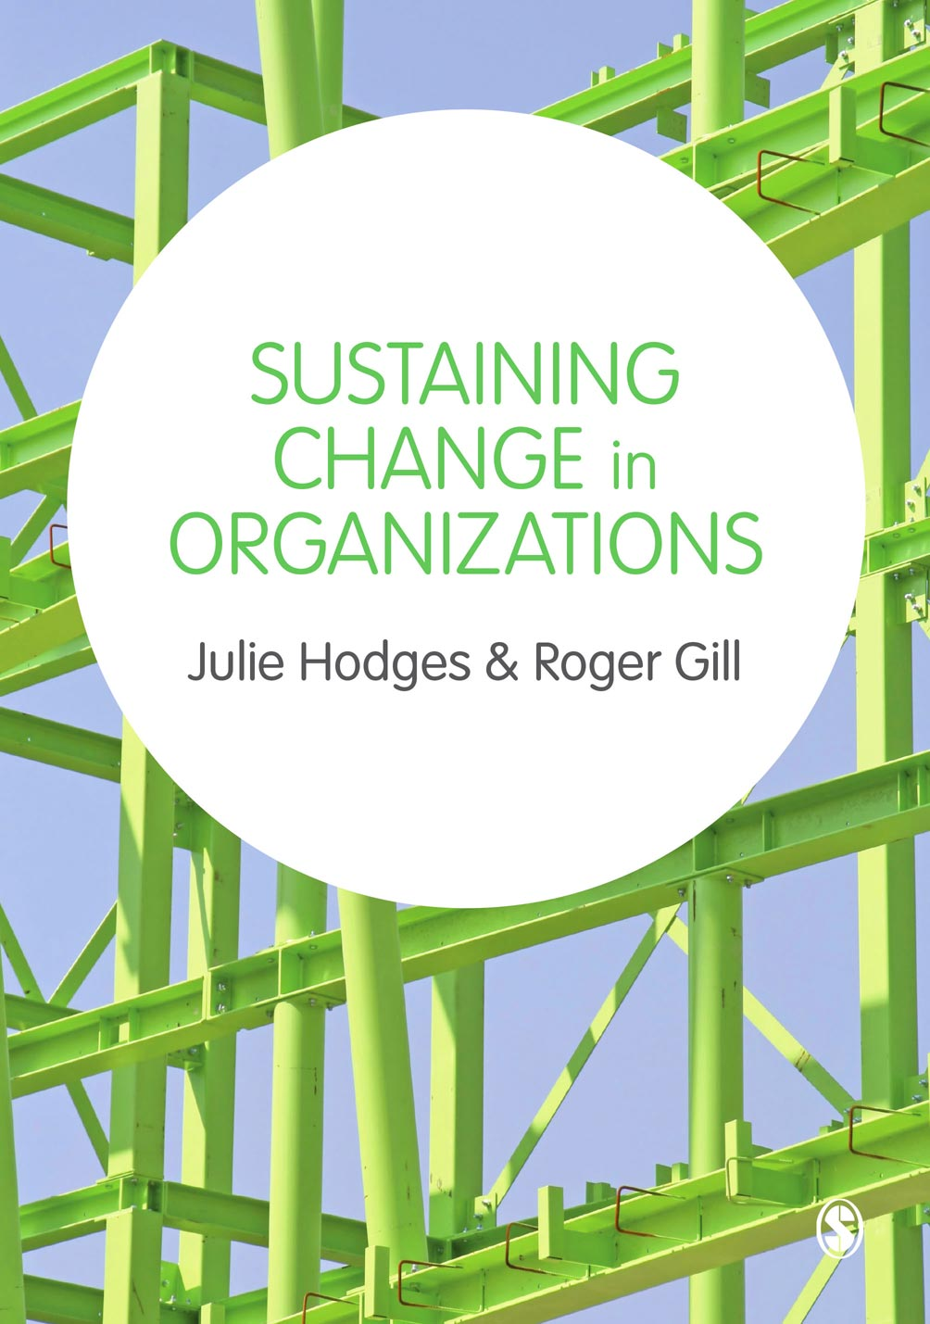
© Julie Hodges and Roger Gill

Slide 2
Chapter 6
Diagnosing the Need and Readiness for Change
© Julie Hodges and Roger Gill

Slide 3
Learning outcomes
Identify the need for change
Apply diagnostic tools to identify the need for change
Identify the readiness for change
© Julie Hodges and Roger Gill

Slide 4
Diagnosis
Organisational diagnosis is ‘a process of research into the functioning of an organisation that leads to recommendations for improvement. In practice it is usually a multi-stage iterative process that begins with change managers using a holistic model of organisational functioning …. Sometimes this process is reversed and change managers focus their attention on specific components of organisational functioning (such as motivation, group processes, leadership, task design, information systems, organisational structure or climate) in order to help them understand the total picture.’
Postma & Kok (1999: 585)
© Julie Hodges and Roger Gill

Slide 5
Future – Now model
Force Field Analysis
7s
COPS
Burke-Litwin
© Julie Hodges and Roger Gill

Slide 6
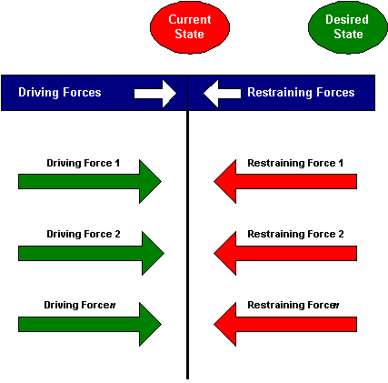
Force Field Analysis (Lewin) – Driving forces for and against change
© Julie Hodges and Roger Gill

Slide 7

COPS Model
Culture
Organisation
People
Systems
© Julie Hodges and Roger Gill

Slide 8
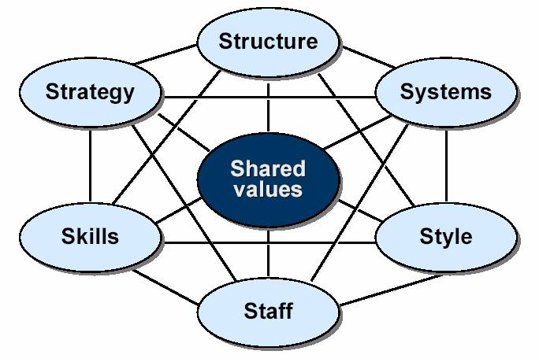
Pascale & Athos Seven S model
© Julie Hodges and Roger Gill

Slide 9
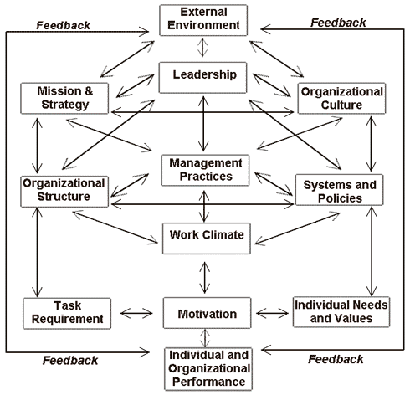
Burke-Litwin Model
© Julie Hodges and Roger Gill

Slide 10
Burke-Litwin Model
Questions to ask using the Burke-Litwin model:
Is the change we are planning for to do with ‘Transformational Change’ or with ‘Transactional Change’, or is it a blend of both? What kind does the organisation really need?
What elements on this diagram have we not yet considered in our change planning? Why is that?
In which 'boxes' will we have problems?
© Julie Hodges and Roger Gill

Slide 11
Steps in the diagnostic process
Selecting a diagnostic model to guide data gathering
Clarifying information requirements
Information gathering
Analysis and interpretation
© Julie Hodges and Roger Gill

Slide 12
When is an organization ready for change?
Preconditions for successful change
Pressure for change.
A clear and shared vision of the goal and direction.
The will and power to act.
Capable people with sufficient resources.
Suitable rewards and accountability.
Actionable first steps.
A capacity to learn and adapt.
© Julie Hodges and Roger Gill

Slide 13
The interaction of readiness and implementation of change.
(Oakland, J.S. and Tanner, S.J. (2006) ‘Quality Management in the 21st century – Implementing Successful Change’, International Journal of Productivity and Quality Management, 1(1-2): 69-87.
© Julie Hodges and Roger Gill

Slide 14
Summary
Diagnosis is a process of research which leads to recommendation. It is not a one off activity.
A mix of diagnostic models should be used in order to provide an internal and external perspective.
Leaders and managers need to consider whether or not change is necessary and if so if there is a readiness for change.
© Julie Hodges and Roger Gill

Slide 15
References
Eccles, T. (1994) Practical change in telling sentences: Succeeding With Change. London: McGraw-Hill
Postma & Kok (1999) ‘Organizational diagnosis in practice: a cross – classification analysis using the DEL technique’, European Management Journal, 17(6), 584–97
© Julie Hodges and Roger Gill

