Slide 1
Deviance and Social Control: An Introduction
Chapter 1
Notes:
Exercise to gauge student’s knowledge – have class name acts of deviance, right them up on the board and use examples in Intro of Nudity celebrated and criminalized to promote thought

Slide 2
What is Deviance?
Things to consider about deviance
  Who? What? Where? When?
Consider these elements in defining what is or is not deviant
  Nudity at the Fremont Arts Council (FAC)
    Appropriate or not??
  Other examples…

Slide 3
Various Conceptions of Deviance
Authors of Deviance textbooks have offered several conceptions of deviance:
  “objectively given” or “subjectively problematic”
  normative conception v. relativist conception
  positivist perspective v. constructionist perspective
The conceptions are similar…just use different language

Slide 4
Objectively Given Deviance
or normative.. or positivistic..
Assumes a general set of norms - rules of behavior that guide people’s actions – exists.
    folkways, everyday norms, basic mannerisms, simple daily activities and do not cause a ruckus
    mores, “moral” norms, have a moral connection, will upset people more than folkways
    and laws, backed by official sanctions, violation of a rule understood by the majority of the group

Slide 5
Subjectively Problematic Conception
or Social Constructionist.. or Reactionist/Relativist
Deviance is constructed based on the interactions of those in society.
behaviors and/or conditions are not inherently deviant
  They are defined as such
the idea of norms and deviance are constructed by immediate society
How are deviant behaviors constructed?
think of examples of behaviors across countries

Slide 6
Critical Conception
Deviance
based on the socio, economic, political statuses in society; behaviors or conditions are not inherently deviant
Deviance is established by those in power
maintain and enhance their power
consider gender, class, social status, etc.

Slide 7
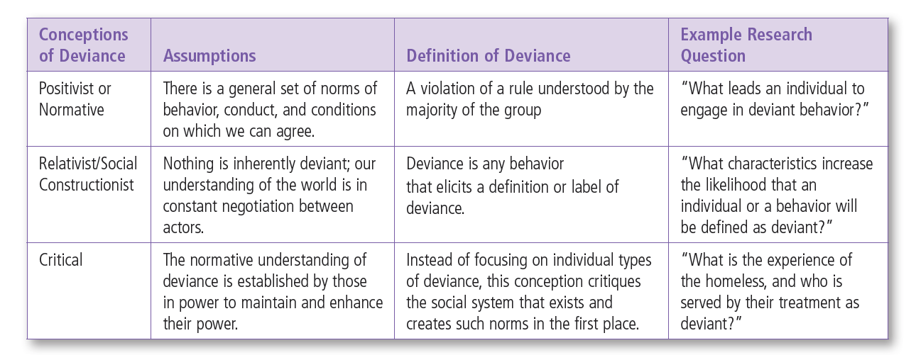
Insert Table 1.1 from text
Notice the similarities and differences in how each conception views deviance.

Slide 8
How do YOU define deviance?
Picking your nose?
Breaking the speed limit?
Killing someone?
Cheating on a test?
Lying to your parents?
Which conception do you currently use?
Notes:
Have students list something deviant that they have done on a post it note. These should be anonymous. Discuss each with the class and determine if folkway, mores, or law and then discuss which conception they are using.

Slide 9
Deviance in Pop Culture
Consider Social deviance in movies , TV shows, and the internet
Different theories can explain the deviant behavior?
Are there different reactions to the deviant behaviors? Why?
Are social policies and social control depicted? How?
Films: Hunger Games, Silver Linings Playbook , The Purge
TV: Reality TV & The Learning Channel feature many shows that portray deviant people and behaviors (My Strange Addiction, Little People Big World, Hoarders), Sister Wives, Seinfeld
Internet: Deviance is at your fingertips. An example could be Nigahiga on YouTube

Slide 10
Understanding Social Deviance
Use of the Sociological Imagination provides for a big picture understanding
Idea discussed by C. Wright Mills
Gives multiple theoretical approaches to understanding
  Salad Bar Example

Slide 11
Salad bar 1.3
The salad bar can represent the restriction on choices that individuals have. We can only make our salad with the ingredients offered.

Slide 12
Understanding Deviance
Theory is important!
  Helps us systematically think about deviance and provide solutions to problems we study
  Gives a big picture
  Individual experiences might not be the norm
    Exceptions do not necessarily make the rule

Slide 13
Understanding Deviance
  Jersey Shore v. the real people of Jersey Shore
    Does the show elude to anything about all people living in New Jersey or the towns the show Jersey Shore is recorded in?
    What about youth and the lifestyle of those similar in age to the cast on Jersey Shore?

Slide 14
Understanding Deviance
Can you think of other shows?
    Is reality really reality for the people its aimed to portray?
    How can that influence your perceptions of them?
    Does an understanding provide solutions to problems (such as differences we encounter among one another)?

Slide 15
Use of the Scientific Method
Scientific method - systematic procedure that helps safe-guard against researcher bias
  Step1 - Research question
  Step 2 - Data and data collection methods
  Step 3 – Analyze data
  Step 4 – Results and theory

Slide 16
Book Features: Chapters will include
Street Deviances vs Elite Deviance
  Juxtaposes “street” deviance to “elite” deviance
  Much focus tends to be on street deviance but to be systematic we must look at both
Ideas in Action
  Discussion of Public Policy to include both public and private programs
Now You
  Gives the student a chance to implement what they have just learned.

Slide 17
Purpose of the Book
Goals in this course:
  1) an introduction to deviance – types of deviance and researching deviance
  2) traditional theories of deviance (positivist theories)
  3) social constructionist theories of deviance (SCR, critical perspectives)
  4) responses to deviance
Think about why deviance occurs, why some behavior may or may not be defined as deviant, and why some individuals are more likely to be defined as deviant

Slide 18
Open-Access Student Resources
SAGE Journal Articles
Multimedia Resources
Visit study.sagepub.com/paynewccess2e to access these free resources!

