Slide 1
Epstein, Constitutional Law for a Changing America, Edition 12 Chapter 1: Understanding the U.S. Supreme Court

Slide 2
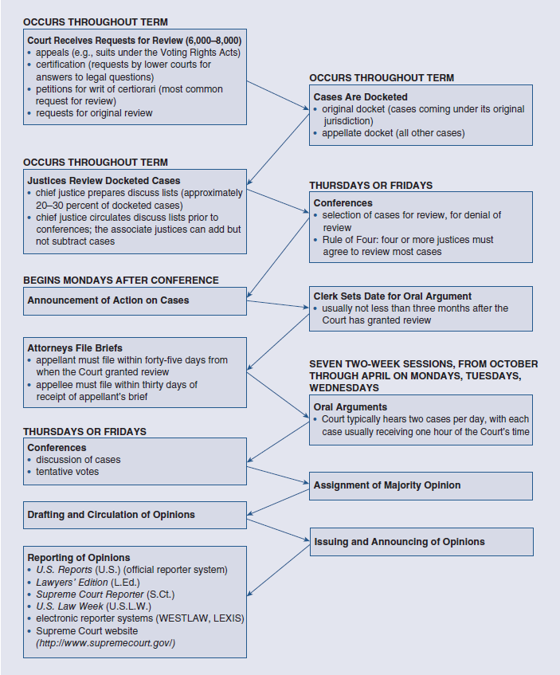
Processing Supreme Court Cases (1 of 8)
Figure 1.1 The Processing of Cases
Access the long description for image.
Source: Compiled by authors.

Slide 3
Processing Supreme Court Cases (2 of 8)
Deciding to Decide: The Supreme Court’s Caseload: How Cases Get to the Court: Jurisdiction and the Routes of Appeal
Ways cases come to court.
Original cases.
How to invoke appellate jurisdiction.
Notes:
Processing Supreme Court Cases
Deciding to Decide: The Supreme Court’s Caseload
How Cases Get to the Court: Jurisdiction and the Routes of Appeal
Cases come to the Court in one of four ways:
A request for review under the Court’s original jurisdiction.
One of three appellate routes—appeals, certification, and petitions for writs of certiorari.
Original cases are those that no other court has heard.
The Court normally reviews only those cases in which one state is suing another.
To invoke the Court’s appellate jurisdiction, litigants can take one of three routes, depending on the nature of their dispute:
Cases “on appeal” involve issues Congress has determined are so important that a ruling by the Supreme Court is necessary.
Lower appellate courts can file writs of certification asking the justices to respond to questions aimed at clarifying federal law.
In a petition for a writ of certiorari, the litigants seeking Supreme Court review ask the Court, literally, to become “informed” about their cases by requesting the lower court to send up the record.

Slide 4
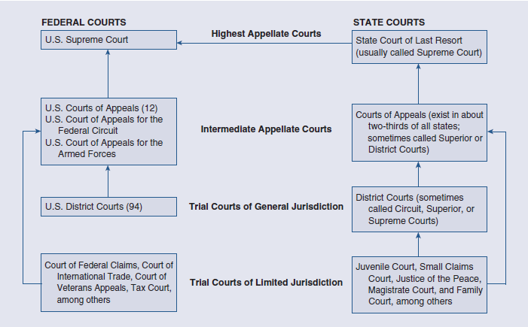
Processing Supreme Court Cases (3 of 8)
Figure 1.2 The American Court System
Access the long description for image.
Source: Compiled by authors.

Slide 5
Processing Supreme Court Cases (4 of 8)
Deciding to Decide: The Supreme Court’s Caseload: How to Court Decides: The Case Selection Process
Original pool of petitions faces.
Collaboration of different chamber clerks.
Circulation of a “discuss list.”
When Courts grants certiorari.
Notes:
Processing Supreme Court Cases
A. Deciding to Decide: The Supreme Court’s Caseload
How the Court Decides: The Case Selection Process
The original pool of about six to eight thousand petitions faces several checkpoints.
The clerk’s office examines petitions to make sure they are in proper form and conform to the Court’s precise rules.
Clerks from the different chambers collaborate by dividing, reading, and then writing memos on the petitions.
The justices then use the pool memos, along with their clerks’ reports, as a basis for making their own independent determinations about which cases they believe are worthy of a full hearing.
Before the justices meet to make case selection decisions, the chief circulates a “discuss list” containing those cases they feel merit consideration.
The discussion of each petition begins with the chief justice presenting a short summary of the facts and, typically, stating their vote.
The associate justices then comment on each petition in order of seniority.
By tradition, the Court grants certiorari to those cases receiving the affirmative vote of at least four justices.

Slide 6
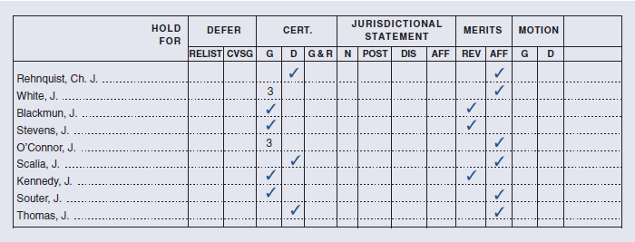
Processing Supreme Court Cases (5 of 8)
Figure 1.3 A Page from Justice Harry Blackmun’s Docket Books
Access the long description for image.
Source: Dockets of Harry A. Blackmun, Manuscript Division, Library of Congress, Washington, DC.
Notes:
Note: As the docket sheet shows, the justices have a number of options when they meet to vote on cert. They can grant (G) the petition or deny (D) it. They also can cast a “Join 3” (3) vote. Justices may have different interpretations of a Join 3 but, at the very least, it tells the others that the justice agrees to supply a vote in favor of cert if three other justices support granting review. In the MERITS column, REV = reverse the decision of the court below; AFF = affirm the decision of the court below.

Slide 7
Processing Supreme Court Cases (6 of 8)
Deciding to Decide: The Supreme Court’s Caseload: Considerations Affecting Case Selection Decisions
Considerations listed in Rule 10.
Three important political factors.
Notes:
Processing Supreme Court Cases
A. Deciding to Decide: The Supreme Court’s Caseload
Considerations Affecting Case Selection Decisions
Legal considerations are listed in Rule 10, which the Court has established to govern the certiorari decision-making process.
Three are particularly important political factors that may influence the Court’s case selection process:
The U.S. solicitor general (SG).
The amicus curiae (friend of the court) brief.
The ideology of the justices.

Slide 8
Processing Supreme Court Cases (7 of 8)
The Role of Attorneys
Written Arguments.
Oral Arguments.
Notes:
Processing Supreme Court Cases
The Role of Attorneys
Written Arguments
Written arguments, called briefs, are the major vehicles for parties to Supreme Court cases to document their positions.
The appealing party (known as the appellant or petitioner) must submit its brief within forty-five days of the time the Court grants certiorari.
The opposing party (known as the appellee or respondent) has thirty days after receipt of the appellant’s brief to respond with arguments urging affirmance of the lower court ruling.
The justices may use written briefs to formulate the questions they ask the lawyers representing the parties.
Those wishing to submit friend of the court briefs must obtain the written permission of the parties or the Court.
Oral Arguments
Each side has thirty minutes to convince the Court of the merits of its position and to field questions from the justices.
In some important cases, the Court will allocate additional time for arguments.
The justices can interrupt the attorneys at any time with comments and questions.
Oral arguments are the only part of the Court’s decision-making process that occurs in public.

Slide 9
Processing Supreme Court Cases (8 of 8)
The Supreme Court Decides: Some Preliminaries
The Conference.
Opinion Assignment and Circulation
Notes:
Processing Supreme Court Cases
The Supreme Court Decides: Some Preliminaries
The Conference
The Court insists that its decisions take place in a private conference, with no one in attendance except the justices.
The Court is supposed to base its decisions on factors other than public opinion.
Although the Court reaches tentative decisions on cases, the opinions explaining the decisions remain to be written.
The justices have not experienced many information leaks.
Dobbs v. Jackson Women’s Health Organization.
After the public announcement of a decision, clerks and even justices have sometimes thrown their own sunshine on the Court’s deliberations.
National Federation of Independent Business v. Sebelius (2012).
The chief justice presides over the deliberations.
He calls up the case for discussion and then presents his views about the issues and how the case should be decided.
The remaining justices state their views and vote in order of seniority.
The level and intensity of discussion differ from case to case.
Opinion Assignment and Circulation
When the chief justice votes with the majority, they assign the writing of the opinion.
When the chief justice votes with the minority, the assignment task falls to the most senior member of the Court who voted with the majority.
First and perhaps foremost, the assigner tries to equalize the distribution of the Court’s workload.
They may also consider the justices’ particular areas of expertise.
There has been a tendency among chief justices to self-assign especially important cases.
Brown v. Board of Education (1954).
For cases decided by a one-vote margin, chiefs have been known to assign the opinion to a moderate member of the majority.
The writer begins the process by circulating an opinion draft to the others.
Once the justices receive the first draft of the opinion, they have many options:
They can join the opinion.
They can ask the opinion writer to make changes.
They can tell the opinion writer that they plan to circulate a dissenting or concurring opinion.
They can tell the opinion writer that they await further writings.
Many different opinions on the same case, at various stages of development, may be floating around the Court over the course of several months.
Eventually, the final version of the opinion is reached, and each justice expresses a position in writing or by signing an opinion of another justice.

Slide 10
Supreme Court Decision Making: Legalism (1 of 8)
Legalistic theory of judicial decision.
Realistic theory of judging.
Reasons justices follow legal approaches.
Methods of constitutional interpretation.
Notes:
Supreme Court Decision Making: Legalism
The legalistic theory of judicial decision-making focuses on the role of law and legal methods in determining how justices interpret the Constitution.
The realistic theory of judging emphasizes nonlegalistic factors, including the role of politics.
There are reasons to believe that justices seek to follow a legal approach:
The justices themselves often say they look to the founding period, the words of the Constitution, previously decided cases, and other legalistic approaches.
The justices are obliged to be “principled in their decision-making process.”
Legalism in constitutional law centers on the methods of constitutional interpretation.

Slide 11
Supreme Court Decision Making: Legalism (2 of 8)
Originalism
Interpretation of the Constitution.
Intentionalism: objectives of framers.
Original meaning or understanding.
Critics of originalism.
Notes:
Supreme Court Decision Making: Legalism
Originalism
Originalists attempt to interpret the Constitution in line with what it meant at the time of its drafting.
One form of originalism, intentionalism, emphasizes the objectives or purposes of the Constitution’s framers.
Hylton v. United States
Hustler Magazine v. Falwell (1988)
Advocates of this approach offer several justifications for the relevance of the intent of the framers.
The framers acted in a calculated manner.
If justices scrutinize the intent of the framers, they can deduce “constitutional truths,” which produces neutral principles of law and eliminates value-laden decisions.
It fosters stability in law.
Another form is original meaning or understanding.
It emphasizes “the meaning a reasonable speaker of English would have attached to the words, phrases, sentences, etc. at the time the particular provision was adopted.”
The merits of this approach are similar to those of intentionalism.
Nixon v. United States (1993).
Originalism has generated many critics over the years.
Thurgood Marshall did not believe that the Constitution’s meaning was “forever ‘fixed’ at the Philadelphia Convention.”
One reason for the controversy is that originalism became highly politicized in the 1980s.
Justice Brennan argued that if the justices employed only this approach, the Constitution would lose its applicability and be rendered useless.
A criticism often leveled at intentionalism is that the Constitution embodies not one intent but many.
District of Columbia v. Heller (2008).

Slide 12
Supreme Court Decision Making: Legalism (3 of 8)
Textualism
Looks at the literal meaning.
Overlaps with originalism.
Value-free form of jurisprudence.
Justice Black’s literal brand.
Notes:
Supreme Court Decision Making: Legalism
Textualism
Textualists look no further than the words of the Constitution to reach decisions, without seeking the intended meanings behind the words.
Under the original meaning approach, it is fair game for consider what the words would have ordinarily meant to the people of that time.
Pure textualists or literalists, believe that justices ought to consider only the words in the constitutional text, and the words alone.
Originalism and pure textualism sometimes overlap and sometimes lead to radically different results.
Textual analysis is quite common in Supreme Court opinions.
Like originalists, advocates viewed textualism as a value-free form of jurisprudence.
Justice Black’s literal brand of jurisprudence has been vulnerable to attack.
Some assert that it led him to take some rather peculiar positions.
Another objection is that literalism can result in inconsistent outcomes.
Additionally, it presupposes a precision in the English language that does not exist.
Finally, despite the precision of some constitutional provisions, they are loaded with “reasons, goals, values, and the like.”

Slide 13
Supreme Court Decision Making: Legalism (4 of 8)
Structural Analysis
Interpretation following overarching structures.
Structures are important.
Examples of structural analysis.
Notes:
Supreme Court Decision Making: Legalism
Structural Analysis
Structural reasoning suggests that interpretation of Constitutional clauses should follow from, or at least be consistent with, overarching structures or governing principles established in the Constitution.
These structures are so important that judges and lawyers should read the Constitution with an eye toward preserving them.
There are many famous examples of structural analyses.
McCulloch v. Maryland (1819).
Structural reasoning does not necessarily lead to a single answer in each and every case.
INS v. Chadha (1983).

Slide 14
Supreme Court Decision Making: Legalism (5 of 8)
Stare Decisis
“Let the decision stand.”
Precedent can be important.
Precedent is window dressing.
Notes:
Supreme Court Decision Making: Legalism
Stare Decisis
“Let the decision stand.”
Jurists should decide cases on the basis of previously established rulings, or precedent.
The law they generate becomes predictable and stable.
Precedent can be an important factor in Supreme Court decision making.
Many allege that judicial appeal to precedent often is mere window dressing.
The Court has generated so much precedent that it is usually possible for justices to find support for any conclusion.
It may be difficult to locate the rule of law emerging in a majority opinion.
“Establishing the principle of the case,” or the ratio decidendi.
Many justices recognize the limits of stare decisis in cases involving constitutional interpretation.

Slide 15
Supreme Court Decision Making: Legalism (6 of 8)
Table 1.2: Precedents Overruled, 1953–2022 Terms
Source: Calculated by the authors from data in the U.S. Supreme Court Database (http://supremecourtdatabase.org).
Court Era (Terms) | Number of Terms | Number of Overruled Precedents | Average Number of Overrulings per Term
Warren Court (1953–1968) | 16 | 45 | 2.8
Burger Court (1969–1985) | 17 | 54 | 3.2
Rehnquist Court (1986–2004) | 19 | 43 | 2.3
Roberts Court (2005–2022) | 18 | 28 | 1.6
Notes:
[In the seven decades covered in the table, the Court overturned only 170 precedents, or, on average, about 2.4 per term. What is more, the justices almost always cite previous rulings in their decisions; indeed, it is the rare Court opinion that does not mention other cases. Finally, several scholars have verified that precedent helps to explain Court decisions in some areas of the law. In one study, analysts found that the Court reacted quite consistently to legal doctrine presented in more than fifteen years of death penalty litigation. Put differently, using precedent from past cases, the researchers could correctly categorize the outcomes (for or against the death penalty) in 75 percent of sixty-four cases decided since 1972. Scholarly work considering precedent in search and seizure litigation has produced similar findings.]

Slide 16
Supreme Court Decision Making: Legalism (8 of 9)
Pragmatism
Effects of decisions on society.
Creation and analysis of rules.
Notes:
Supreme Court Decision Making: Legalism
Pragmatism
The members of the Court often consider the effects of a decision for different segments of society.
This interpretive approach often takes the form of a balancing exercise.
A justice will select from among plausible constitutional interpretations the one that has the best consequences.
Justices may attempt to create rules, or analyze existing ones, so that they maximize benefits and minimize costs.
United States v. Leon (1984).

Slide 17
Supreme Court Decision Making: Legalism (9 of 9)
Polling Other Jurisdictions
Probing of English traditions.
Methods is not bulletproof.
Practices of other jurisdictions.
Notes:
Supreme Court Decision Making: Legalism
Polling Other Jurisdictions
A justice might probe English traditions or early colonial or state practices to determine how public officials of the times—or of contemporary times—interpreted similar words or phrases.
Wolf v. Colorado (1949).
Rochin v. California (1952).
Mapp v. Ohio (1961).
The method is far from foolproof.
The Constitution of 1787 as it initially stood and has since been amended rejects many English and some colonial and state practices.
Even a steady stream of precedents from the states may signify nothing more than that judges imitated each other under the rubric of stare decisis.
It is difficult to imagine how the thinking of people in the eighteenth century could be used to evaluate government practices in the twentieth and twenty-first centuries.
The Supreme Court continues to consider the practices of other U.S. jurisdictions.
Courts in other societies occasionally look to their counterparts elsewhere.
The State v. Makwanyane (1995)
United States v. Alvarez-Machain (1992)

Slide 18
Supreme Court Decision Making: Realism (1 of 6)
Preference-Based Approaches
Judicial Attitudes.
Judicial Role.
Notes:
Supreme Court Decision Making: Realism
Preference-Based Approaches
Preference-based approaches see the justices as rational decision makers who hold certain values they would like to see reflected in the outcomes of Court cases.
Judicial Attitudes
Attitudinal approaches emphasize the centrality of the justices’ political ideologies.
Each justice evaluates the facts of disputes and arrives at decisions consistent with their personal ideology.
C. Herman Pritchett was one of the first scholars to study the relevance of the justices’ personal attitudes.
Pritchett observed that dissent had become an institutionalized feature of judicial decisions.
Pritchett concluded that the justices were “motivated by their own preferences.”
Pritchett’s findings touched off an explosion of research on the influence of attitudes on Supreme Court decision making.
Much scholarship attempts to predict justices’ voting behavior based on their ideological preferences.
Data show dramatic differences among four important jurists, especially in cases involving civil liberties.
The liberal position is a vote in favor of the individual who is claiming a denial of these basic rights.
Economics cases involve challenges to the government’s authority to regulate the economy.
The liberal position supports an active role by the government in controlling business and economic activity, and a conservative position opposes such government intervention.
It is common to describe a particular era of the Court in terms of its political preferences.
Preference-based approaches are not foolproof.
They can involve circular reasoning.
Knowing that the Court decided a case in a liberal or conservative way does not tell us much about the Court’s actual policy positions.
Ideological labels are occasionally bound to particular historical eras.
Muller v. Oregon (1908).
Some decisions do not fall neatly on a single conservative-liberal dimension.
Wisconsin v. Mitchell (1993).
Judicial Role
The judicial role is norms that constrain the behavior of jurists.
Each justice has a view of his or her role.
The view that is based far less on political ideology and far more on fundamental beliefs of what a good judge should do or what the proper role of the Court should be.
Analysts typically discuss judicial roles in terms of activism and restraint.
An activist justice believes that the proper role of the Court is to assert independent positions in deciding cases, to review the actions of the other branches vigorously, to be willing to strike down acts the justice believes are unconstitutional, and to impose far-reaching remedies for legal wrongs whenever necessary.
A restraint-oriented justice believes courts should not become involved in the operations of the other branches unless it is absolutely unavoidable, the benefit of the doubt should be given to actions taken by elected officials, and courts should impose remedies that are narrowly tailored to correct a specific legal wrong.
We might expect to find activist justices more willing than their opposites to strike down legislation.
Although the justices do differ, they all show a willingness to join their colleagues in casting aside laws whose validity they question.
Judicial activism and restraint do not necessarily equal judicial liberalism and conservatism.

Slide 19
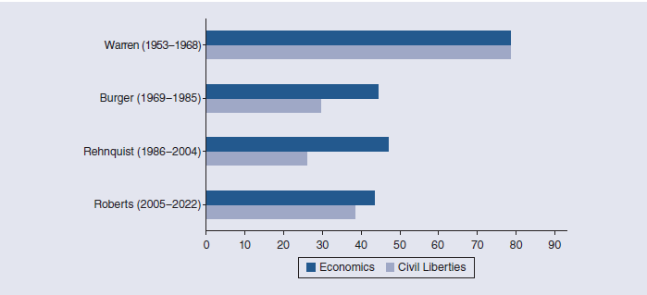
Supreme Court Decision Making: Realism (2 of 6)
Figure 1.4 Percentage of Cases in Which Each Chief Justice Voted in the Liberal Direction, 1953–2022 Terms
Access the long description for image.
Source: Calculated by the authors from data in the U.S. Supreme Court Database (http://supremecourtdatabase.org).

Slide 20
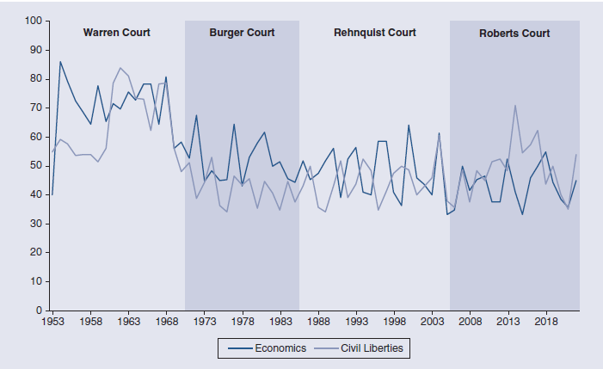
Supreme Court Decision Making: Realism (3 of 6)
Figure 1.5 Court Decisions on Economics and Civil Liberties, 1953–2022 Terms
Access the long description for image.
Source: Calculated by the authors from data in the U.S. Supreme Court Database (http://supremecourtdatabase.org).

Slide 21
Supreme Court Decision Making: Realism (4 of 6)
Table 1.3: Percentage of Votes to Invalidate Laws as Unconstitutional, 2005–2022 Terms
Source: Calculated by the authors from data in the U.S. Supreme Court Database (http://supremecourtdatabase.org).
Justice | Federal Laws | State and Local Laws
Kavanaugh | --- | 100
Gorsuch | --- | 86.7
Roberts | 80 | 76.7
Thomas | 76 | 60.5
Kagan | 72.2 | 65.6
Alito | 72 | 66.7
Sotomayor | 54.5 | 64.7
Notes:
Note: The figures shown indicate the percentage of cases in which each justice voted with the majority to invalidate laws as unconstitutional. Twenty-five cases struck down federal laws and forty-three cases struck state and local laws. We include only justices currently on the Court who voted in at least ten such cases. Thus, we exclude Amy Coney Barrett and Ketanji Brown Jackson because they each participated in fewer than ten of the cases in both categories. (Some justices in the table may not have participated in all cases.)

Slide 22
Supreme Court Decision Making: Realism (5 of 6)
Strategic Approaches
Propositions of strategic accounts.
Justices’ ability to achieve goals.
Rational choice paradigm.
How strategic behavior manifests.
Notes:
Supreme Court Decision Making: Realism
Strategic Approaches
Strategic accounts of judicial decisions rest on a few simple propositions:
Justices may be primarily seekers of legal policy.
They may be motivated by jurisprudential principles.
They are not unconstrained actors who make decisions based solely on their own ideological attitudes or jurisprudential desires.
Justices are strategic actors who realize that their ability to achieve their goals depends on:
Consideration of the preferences of other relevant actors.
The choices they expect others to make.
The institutional context in which they act.
This approach derives from the rational choice paradigm.
Strategic behavior manifests in many ways.
One way is in the frequency of vote changes.
Another is the revision of opinions that occurs in almost every Court case.
Griswold v. Connecticut (1965).

Slide 23
Supreme Court Decision Making: Realism (6 of 6)
External Factors
Public Opinion.
Partisan Politics.
Interest Groups.
Notes:
Supreme Court Decision Making: Realism
External Factors
Public Opinion
Scholars offer three reasons for the claim that the justices are affected by public opinion.
Because justices are political appointees, they reflect, however subtly, the views of the majority.
The Court, at least occasionally, views public opinion as a legitimate guide for decisions.
The justices have no mechanism for enforcing their decisions, depending on other political officials to support their positions and on general public compliance.
Supporting and contradicting examples.
Korematsu v. United States (1944).
The Court struck down much New Deal legislation, despite public support.
Some scholars doubt that public opinion affects the Court’s decision making.
Norpoth and Segal concluded that new justices create the illusion that the Court echoes public opinion.
Whether public opinion affects Supreme Court decision making is still open for discussion.
Partisan Politics
Many assert that the Court is responsive to the influence of partisan politics, both internally and externally.
It’s possible the justices carry their partisan attachments onto the bench.
Those who have ascended to the Supreme Court have typically had strong connections to political institutions.
Justices who affiliate with the Democratic Party tend to be more liberal in their decision making than those who are Republicans.
Bush v. Gore (2000).
Political pressures from the outside also can affect the Court.
The president has some direct links with the Court.
A less direct source of presidential influence is the executive branch, which can help or hinder the Court in implementing its policies.
Marbury v. Madison.
Another indirect source of influence is the U.S. solicitor general.
The legislature has many powers over the Court the justices cannot ignore.
Congress can restrict the Court’s jurisdiction to hear cases, enact legislation or propose constitutional amendments to recast Court decisions, and hold judicial salaries constant.
Interest Groups
Supreme Court litigation has become political over time.
The most striking example is the incursion of organized interest groups into the judicial process.
Interest groups try to influence Court decisions by submitting amicus curiae briefs.
Regents of the University of California v. Bakke (1978).
Grutter v. Bollinger (2003).
Fisher v. University of Texas (2013).
Obergefell v. Hodges (2015).
Dobbs v. Jackson Women’s Health Organization (2022)
Groups go to the Court to influence the Court’s decisions.
But group also go to set institutional agendas, and to counterbalance other groups.
They also seek to publicize their causes and their organizations.
Brown v. Board of Education (1954).
When interest groups participate on both sides, it is reasonable to speculate that one or more exerted some intellectual influence.
In some instances, the Court’s opinion may cite directly an argument advanced in an amicus brief.
That might indicate merely that a justice is citing the brief to support a conclusion he or she had already reached.
Attorneys for some groups are often more experienced and their staffs more adept at research than “one-shotters.”
Some evidence suggests that attorneys working for interest groups are no more successful than private counsel.

Slide 24
Conducting Research on the Supreme Court
Locating Supreme Court Decisions
Four major reporters.
Ancillary material provided.
Forms of case citations.
The Legal Information Institute (LI).
Notes:
Conducting Research on the Supreme Court
Locating Supreme Court Decisions
The four major reporters are:
U.S. Reports.
United States Supreme Court Reports, Lawyers’ Edition.
Supreme Court Reporter.
U.S. Law Week.
They vary in the kinds of ancillary material they provide.
Case citations take different forms, but they all work in roughly the same way.
Example: Texas v. Johnson (1989).
491 U.S. 397; U.S. Reports.
105 L. Ed. 2d 342 (1989); United States Supreme Court Reports, Lawyers’ Edition.
109 S. Ct. 2533 (1989); Supreme Court Reporter.
57 U.S.L.W. 4770 (1989); U.S. Law Week.
The first set of numbers is the volume number.
The second set is the starting page number.
Several companies maintain databases of the decisions of federal and state courts, along with a wealth of other information.
The Legal Information Institute (LII) at Cornell Law School, FindLaw, and the Supreme Court itself house Supreme Court opinions and offer an array of search capabilities.

Slide 25
Locating Other Information on the Supreme Court and Its Members
Supreme Court Compendium.
Guide to U.S Supreme Court.
Oxford Companion to Supreme Court.
SCOTUSblog and Supreme Court Database.
Notes:
Locating Other Information on the Supreme Court and Its Members
The Supreme Court Compendium: Two Centuries of Data, Decisions, and Developments, 7th edition, contains information on many dimensions of Court activity.
Guide to the U.S. Supreme Court, 5th edition, provides a fairly detailed history of the Court.
The Oxford Companion to the Supreme Court of the United States, 2nd edition, is an encyclopedia containing entries on the justices, important Court cases, and the amendments to the Constitution.
The Legal Information Institute contains links to various documents (such as the U.S. Code and state statutes) and to a vast array of legal indexes and libraries.
SCOTUSblog provides extensive summaries of pending Court cases, as well as links to briefs filed by the parties and amici.
The U.S. Supreme Court Database provides a wealth of data from the time of the Vinson Court (1946 term) to the present.

Slide 26
Appendix: Accessibility Content, Long Descriptions for Images

Slide 27
Figure 1.1: Long Description (1 of 2)
The steps are presented in a diagonal fashion with arrows:
1. Occurs throughout term: Court receives requests for review (6000-8000):
a. Appeals: (e.g., suits under the Voting Rights Acts)
b. Certification (requests by lower courts for answers to legal questions)
c. Petitions for writ of certiorari (most common request for review)
d. Requests for original review
2. Occurs throughout term: Cases are docketed.
a. Original docket (cases coming under its original jurisdiction)
b. Appellate docket (all other cases)
3. Occurs throughout term: Justices review docketed cases.
a. Chief Justice prepares discuss lists (approximately 20 to 30 percent of docketed cases)
b. Chief Justice circulates discuss lists prior to conferences; the associate justices can add but not subtract cases
4. Thursdays or Fridays: Conferences
a. Selection of cases for review, for denial of review
b. Rule of Four: four or more justices must agree to review most cases
5. Begins Mondays after conference: Announcement of action on cases

Slide 28
Figure 1.1: Long Description (2 of 2)
6. Clerk sets date for Oral Argument: Usually not less than three months after the Court has granted review
7. Attorneys File Briefs:
a. Appellant must file within forty-five days from when the Court granted review
b. Appellee must file within thirty days of receipt of appellant’s brief
8. Seven two-week sessions from October through April on Mondays, Tuesdays, and Wednesdays:
a. Oral arguments: Court typically hears two cases per day, with each case usually receiving one hour of the Court’s time.
9. Thursdays or Fridays: Conferences
a. Discussion of cases
b. Tentative votes
10. Assignment of majority opinion
11. Drafting and circulation of opinions
12. Issuing and announcing of opinions
13. Reporting of opinions:
a. U.S. Reports (U.S.) (of¬ficial reporter system)
b. Lawyers’ Edition (L.Ed.)
c. Supreme Court Reporter (S.Ct.)
d. U.S. Law Week (U.S.L.W.)
e. electronic reporter systems (WESTLAW, LEXIS)
f. Supreme Court website: (http://www.supremecourt.gov/)
Access the corresponding image.

Slide 29
Figure 1.2: Long Description
The four levels from bottom to top are: Trial courts of limited jurisdiction, Trial courts of general jurisdiction, Intermediate appellate courts, and Highest appellate courts. The two columns are federal courts and state courts.
Under Trial courts of limited jurisdiction:
The federal courts are the Court of Federal Claims, Court of International Trade, Court of Veterans Appeals, Tax court, among others. An arrow connects these courts to the intermediate appellate courts directly.
The state courts are Juvenile Court, Small Claims Court, Justice of the Peace, Magistrate Court, and Family Court among others. An arrow connects these courts to the intermediate appellate courts directly.
Under Trial courts of general jurisdiction:
The federal courts are U.S. District Courts (94).
The state courts are District Courts (sometimes called Circuit, Superior, or Supreme Courts).
Under Intermediate appellate courts:
The federal courts are U.S. Courts of Appeals (12), U.S. Court of Appeals for the Federal Circuit, U.S. Court of Appeals for the Armed Forces. An arrow connects these courts to the highest appellate courts.
The state courts are Courts of Appeals (exist in about two-thirds of all states; sometimes called Superior or District Courts). An arrow connects these courts to the highest appellate courts.
Under highest appellate courts:
The federal court is the U.S. Supreme Court.
The state court is the State Court of Last Resort (usually called Supreme Court). An arrow connects this court to the U.S. Supreme Court.
Access the corresponding image.

Slide 30
Figure 1.3: Long Description
The table has six columns and nine rows. The titles of the columns are: Hold for, defer, cert., jurisdictional statement, merits, and motion. The defer column is divided into two sub columns: relist and CVSG. The cert. column is divided into three sub columns: G, D, G and R. The jurisdictional statement column is divided into four sub columns: N, Post, Dis, Aff. The merits column is divided into two sub columns: Rev, Aff. The motion column is divided into two sub columns: G, D.
The entries are:
Rehnquist, Ch. J.: Tick shown for Cert.: D and Merits: Aff. Other columns are empty.
White, J.: 3 in Cert: G and tick in Merits: Aff. Other columns are empty.
Blackmun, J.: Tick shown in Cert: G and Merits: Rev. Other columns are empty.
Stevens, J.: Tick shown in Cert: G and Merits: Rev. Other columns are empty.
O’Connor, J.: 3 in Cert: G and tick in Merits: Aff. Other columns are empty.
Scalia, J.: Tick shown for Cert.: D and Merits: Rev. Other columns are empty.
Kennedy, J.: Tick shown in Cert: G and Merits: Rev. Other columns are empty.
Souter, J.: Tick shown in Cert: G and Merits: Aff. Other columns are empty.
Thomas, J.: Tick shown for Cert.: D and Merits: Aff. Other columns are empty.
Access the corresponding image.

Slide 31
Figure 1.4: Long Description
The x-axis has numbers from 0 to 90 in intervals of 10. The y-axis shows two horizontal bars corresponding to economics and civil liberties. has the following names from top to bottom:
Warren (1953−1968): economics: 80; civil liberties: 80
Burger (1969−1985): economics:45; civil liberties: 30
Rehnquist (1986−2004): economics:48; civil liberties: 28
Roberts (2005−2022): economics: 43; civil liberties: 38
Access the corresponding image.

Slide 32
Figure 1.5: Long Description (1 of 2)
The x-axis shows years from 1953 to 2018 in intervals of 5 years. The y-axis shows the number of court decisions on economics and civil liberties. The y-axis values are 0 to 100 in intervals of 10.
The Warren Court is shown from 1953 to 1970, the Burger Court from 1970 to 1986, the Rehnquist Court from 1986 to 2005, and the Roberts Court from 2005 to 2018.
The line for economics starts from 40 in 1953 and goes up to 88 and then comes down to 65 in 1958. It then goes up to 78 and then comes down to 66 and then goes up to 70 and then 75 in 1963. It comes down to 72 and goes up to 78 where it forms a small plateau. It then comes down to 65 and goes up to 80. In 1968 it comes down to 58. This stretch corresponds to the Warren Court.
From 58 it goes up to 60 and comes down to 52. It then goes up to 68 and comes down to 45 in 1973. It goes up to 47 and then back to 45 and then goes up to 65. It then comes down to 43 in 1978. It then goes up to 60 and then comes down to 50 in 1983. It further comes down to 45. This stretch corresponds to the Burger Court.
From 45, it goes up to 50, comes down to 45 in 1988 and then to 55. It then comes down to 38 and goes up to 58 in 1993. It then comes down to 40 and goes up to 58 and comes down to 40 in 1998. It then goes up to 60 and comes down to 40 in 2003. It goes up to 58 and comes down to 32. This stretch corresponds to the Rehnquist Court.
From 32, it goes up to 50 and comes down to 45 in 2008. It then goes up to 48 and comes down to 38 and then goes up to 50 in 2013. It then comes down to 32 and goes up to 50 in 2018 and then comes down to 38 and stops at 40. This stretch corresponds to the Roberts Court.

Slide 33
Figure 1.5: Long Description (2 of 2)
The line for civil services:
It starts at 55 in 1953, goes up to 60 and comes down to 55 in 1958. It comes down to 50 and goes up to 85 in 1963. It then comes down to 70 and then 62 and then goes up to 80 in 1968. It then comes down to 48. This stretch corresponds to the Warren Court.
From 48 it goes up to 50, and then comes down to 38 and goes up to 52 in 1973. It then comes down to 32 and goes up to 48 and comes down to 45 in 1978. It then goes down to 35, up to 45, then down to 35 in 1983 and up to 45 and then to 38. This stretch corresponds to the Burger Court.
From 38 it goes up to 50 and down to 35 in 1988. It then goes up to 50, then down to 40 and then to 50 in 1993. It comes down to 35 and then goes up to 50 in 1998. It then goes down to 40 and then 48 in 2003. It then goes up to 60 and comes down to 38. This stretch corresponds to the Rehnquist Court.
It goes up to 50 and comes down to 38 in 2008. It goes up to 45, 50 and then comes down to 48 in 2013. It then goes up to 70, comes down to 58 and then goes up to 65. It then comes down to 45 in 2018. It then goes up to 50, comes down to 38 and stops at 55. This stretch corresponds to the Roberts Court.
Access the corresponding image.

