Slide 1
How can I improve my English? Seven Mantras for Assured Success

Slide 2
Before we begin, here is an important point:
Don’t be afraid to make mistakes!
And remember:
Making mistakes is an important part of learning a language.
No one has ever learned another language without committing errors.

Slide 3
In the next slide, you will see two sentences. You will have to read and remember them in 15 seconds.

Slide 4
Go to the next slide when the time is up.
Smoking is injurious to health.
She got off the train at a wrong station.

Slide 5
Can you recall them?
Write them down and check with the original sentences.
Check your sentences with the ones that I gave you.
Smoking is injurious to health.
She got off the train at a wrong station.
I bet you have written the first one correctly. But for the second, most non-native speakers would say:
She got down from the train at a wrong station.

Slide 6
She got down from the train at a wrong station.
This is not standard English…a native English speaker won’t use this sentence. But the following sentences are fine:
Smoking is injurious to health.
She got off the train at a wrong station.
You don’t have a problem with the first sentence although ‘injurious’ is not a common word. But you may have a problem with the second.
Why?
Think … before you move on to the next slide.

Slide 7
You don’t have a problem with the first because
You have heard/read
‘Smoking is injurious to health’
hundreds of times.
So you use this sentence without any difficulty.
This means we learn a foreign language by
reading and listening to it repeatedly.
Mantra # 1: Read and listen to good English every day

Slide 8
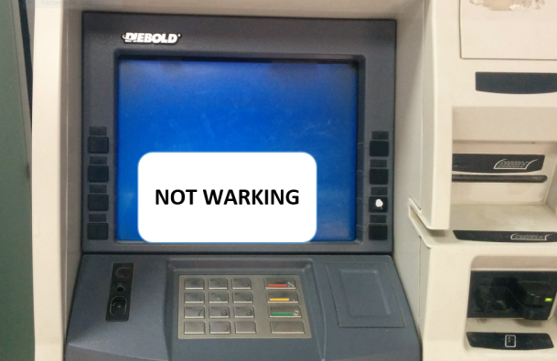
You must listen to and read English
as much as you can, but
Choose what you listen to/read.
Do not try to learn English from:
Signboards ✗
Leaflets ✗
Carton and bottle labels ✗
Notices in hotels, cash machines, etc. ✗
Non-standard newspapers ✗
TV shows where people shout at each other ✗
Unknown origin
On a medicine bottle:
Adults: 1 tablet 3 times a day until passing away

Slide 9
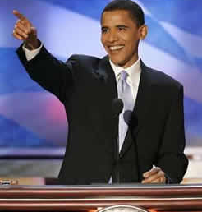
Read and listen to authentic English.
Do read and listen to:
Good writers/speakers around you ✓
Strong speakers on the Internet like in TED talks ✓
Age-old books ✓
Standard newspapers and magazines ✓
Net editions of newspapers ✓
Good TV channels ✓
Good films ✓
Podcasts from authentic sources ✓
Educational videos of famous organizations ✓

Slide 10
When we use English or any language, we
Read |  | Write
Listen to |  | Speak
↑
We learn or receive language through these
↑
Through these we tell people what we think, that is, we produce language

Slide 11
Reading helps you to write.
Listening helps you speak.

Slide 12
Reading helps you to write. Listening helps you speak.
Reading Writing
Listening Speaking
But how does it happen?
Is it automatic?
?
Think … before you move on to the next slide.

Slide 13
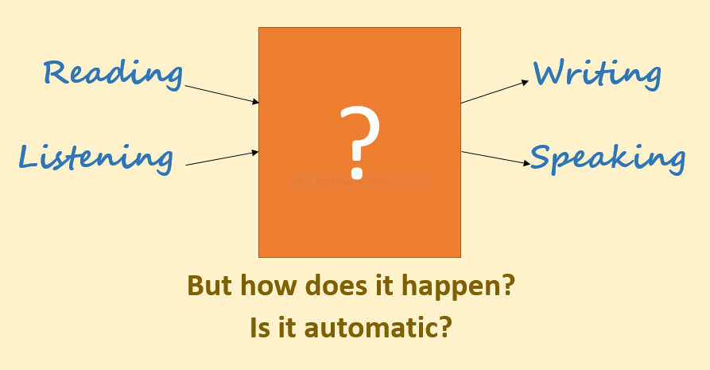
No!
It isn’t. But we can make it happen!
You can learn to speak and write English.
(It takes time, but you can, trust me! ☺)
Let’s begin

Slide 14
Read/listen to accurate English every day! But in a special way!
When you watch TV/read a newspaper, you look for information or entertainment.
From now on, focus on the language too.
Be an active listener and reader.
[Photo: http://web.archive.org/web/20071226081329/teachpol.tcnj.edu/amer_pol_hist/thumbnail427.html]

Slide 15
What does an active listener/reader do?
They focus on useful words, expressions, and pronunciations that are new to them. This brings us to the second mantra:
For example:
She got off the train at a wrong station.
So she got home late.
Mantra # 2: Focus on words/expressions you have never used, but which you may use.

Slide 16
OK, you’ve focused on new expressions, but how will you remember them?
Language experts say: If you don’t go back to new words/expressions five or six times, you may not remember them.
Therefore, you must note down ‘new language’ in a
personal wordbook.
.

Slide 17
Jot down new language.
Mantra # 3: Record new words, expressions and pronunciation in a personal workbook.

Slide 18
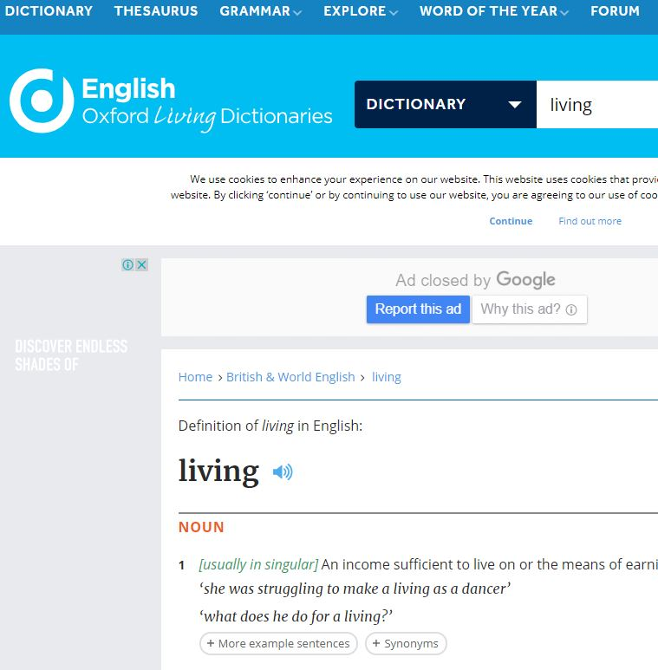
The next question is: What should you note down?
Don’t just jot down words.
Use a good dictionary if you wish (but not always).
And note down:
Words and their meanings
How they are pronounced (in your own language)
How they are used, that is, complete expressions

Slide 19
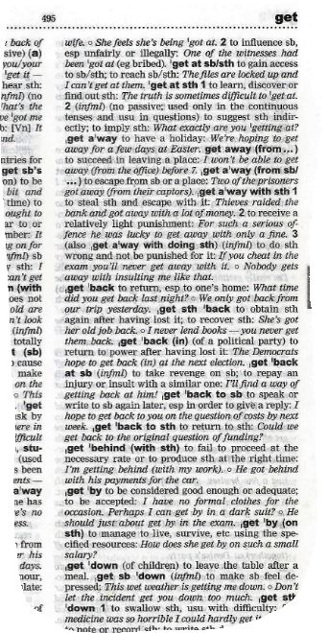
Here are some examples:
You know what the word get means. You can say:
The winner of the lottery will get a Honda bike.
But to speak fluently, you have to use expressions like:
She got off the train at a wrong station.
She got home late (More natural than ‘She reached home late’.)
Go, get a Band-Aid quick, he’s hurt! (Bring a Band-Aid)
He gets on with his colleagues. (He has good relation with colleagues.)
When you come across something new and useful, make a note.

Slide 20
Go back to your notes. After a day, after a week, after a fortnight, after a month …
Mantra # 4: Review the new language your have recorded, if possible, every day.

Slide 21
If you review your wordbook, you will remember the words/expressions. But still you may not be able to use them.
For that, you have to:
Think of situations when you can use the new language.
Imagine you are using the language. Practise using them in your head.

Slide 22
Think when you can use them in real life.
Say the new expressions in your head, or aloud (when no one is around!)
Mantra # 5: Think: roll around the new language
in your head
Mantra # 6: Look for / Create opportunities to speak / write English

Slide 23
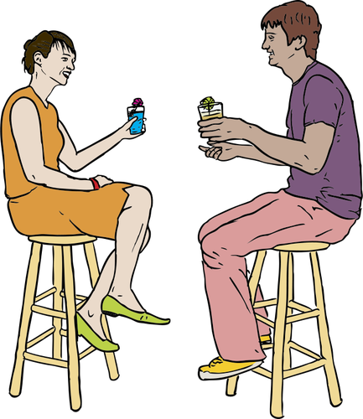
Finally, use them in real life!
Mantra # 7: Write sentences, paragraphs, letters or anything. Write and speak English as much as you can.

Slide 24
Some of you may not have anyone to practise English with
Find out people who too wish to learn English. Make friends.
Teach someone.
If you have an elderly uncle, aunt or grandparent who is free, talk to them in English!
Use the social media extensively—write comments, exchange ideas, argue or start a blog—share your thoughts with the world.
I know someone who used to ring up toll-free numbers and discussed imaginary problems with telephone attendants!

Slide 25
Let’s sum up:
Read and listen to good English every day.
Focus on the new language, particularly what you might use at your college or office.
Record new words, expressions, and pronunciation in a personal wordbook.
Review the new language, if possible, every day.
Think: Roll around the new language in your head.
Look for/create opportunities to speak/write English.
Practise: Speak and write English as much as you can.

Slide 26
There are three ways to improve your English:
Practice,
Practice, and
More practice!

Slide 27
Follow a grammar book
But do remember:
You don’t first learn the rules of grammar and vocabulary, and then speak or write.
It’s the other way round. Learn from authentic sources, use a book on grammar and vocabulary if you have a question. Grammar helps.

Slide 28
Thank you for going through this.
In the next 30 minutes,
Write down what you would like to do to improve YOUR English.
© All the clip art images used in this presentation are from https://publicdomainvectors.org/

